Slide 1
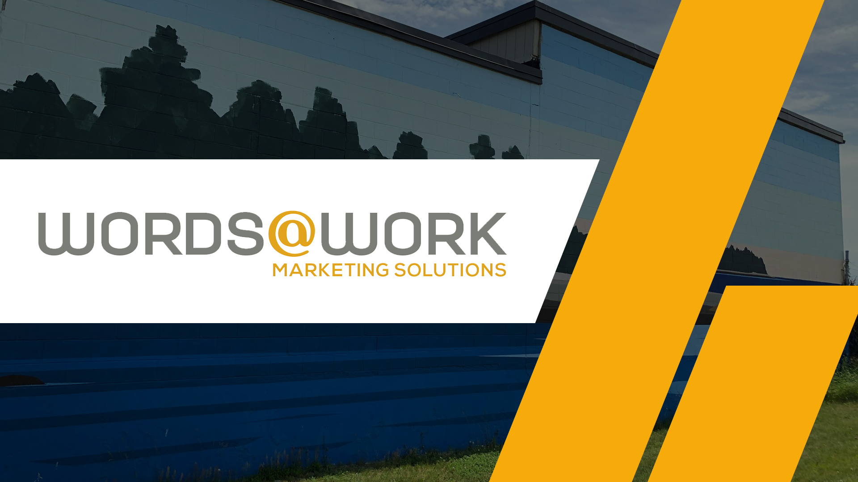

Slide 2
What are we going to talk about today?
Who is Paula?
How does W@W help clients?
Why is a Strategic Plan so important for hospitality businesses?
Setting customer expectations so they choose YOU!

Slide 3
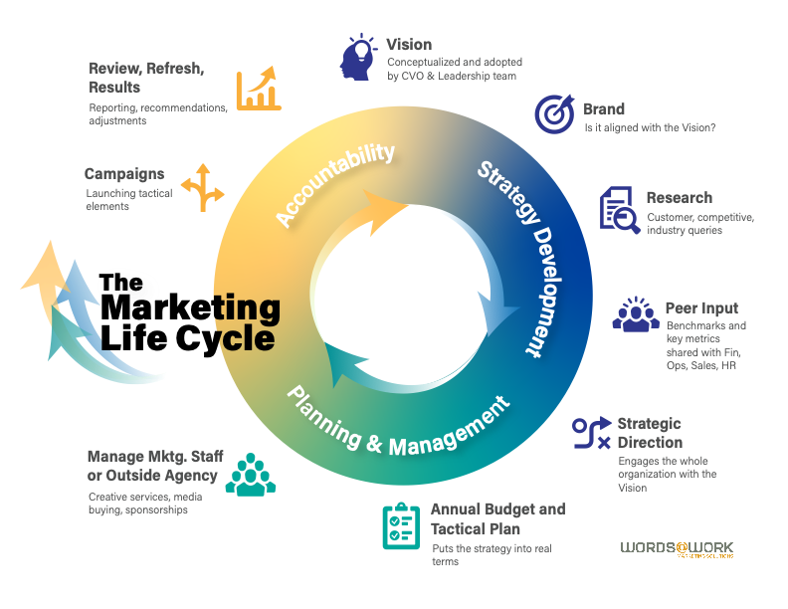

Slide 4
Key reasons companies seek marketing help
Personnel changes leave a big hole in bandwidth & a gap in strategic insight
There’s a new potential that is outside the expertise of the current team (new offering, new market, new territory etc.)
The internal team has a short-term need for extra hands/help

Slide 5
How does a Fractional CMO add value
Strategic alignment with corporate goals
Targeted expertise that is missing in the internal team
Broader perspective across multiple industries and disciplines
Steps in as needed and steps out as completed
Literally only a fraction of the salary of a FTE marketing director or CMO.
Extra hands to get it done (write content, buy media, manage deadlines)

Slide 6
The Strategic Plan is Everyone’s Goal
Communicating the Strategic Plan and Vision in ways that make it real for every member of the team.
Concrete KPIs so everyone feels part of the company’s success.
Emphasizing the importance and value of strategic direction for all aspects of marketing: social media, video, photography, customer experience… everything needs a strategic focus and measurable call to action.

Slide 7












Slide 8
But first….
A couple of intriguing hospitality stories
  Mother of the groom gets moved three times before hotel room is satisfactory.
  Sad family comes to Portland for a new twist on Christmas
  Planning a trip to the Galapagos

Slide 9
A request was sent for tour info for Quito
Planning a trip for January 2026
Stopping in Quito enroute to Galapagos
Questions:
  To/from airport
  Places to stay
  How long to stay
  Night life, dining options, tour ideas?
  Do we need a guide? Group or private?

Slide 10
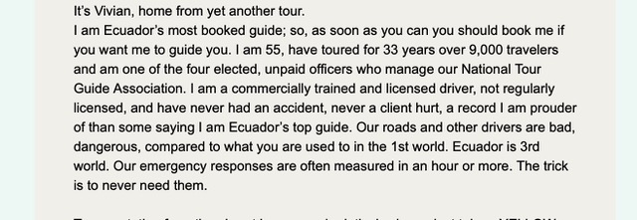

Slide 11
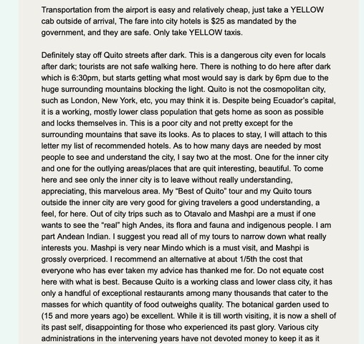

Slide 12
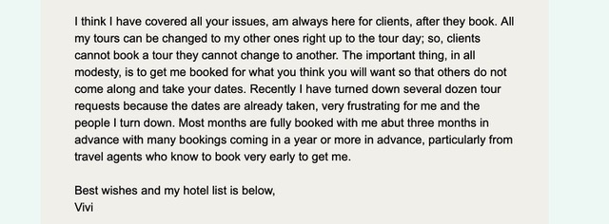

Slide 13
Vivian is a marketing genius
She answered every question.
  How many days
  Options for where to stay
  Advice on what to see
  How to get to/from airport

Slide 14
Vivian is a marketing genius
She enhanced every answer in a way to make you choose her:
  Secret insider info – YELLOW cabs are the best
  Setting the visitor up for success – the botanical gardens are not what you might expect
  She understands how to drive in a 3rd world city
  More than just a safe driver, she knows how long it takes to get MEDCU

Slide 15
My favorite line in her note:
This is a poor city and not pretty.
  But in her capable hands, you will have a good, safe, and memorable experience.

Slide 16
Most of all…
She set a new expectation for this traveler when reviewing other options.

Slide 17
What she didn’t do
Apologize for her country
Brag about having the most 5 Star reviews
Offer any pricing
Offer any availability
Promise anything
Gush about how much everyone enjoy her tours

Slide 18
Instead, she created a real sense of urgency…
Using phrases like
  I am Ecuador’s most booked guide
  I have toured 33 years over 9,000 travelers
  The important thing, in all modesty, is to get me booked
  Recently I have had to turn down several dozen tours
  Most months are fully booked about 3 months in advance

Slide 19
How do we apply this formula to Portland?
First we have to understand the expectations of the prospective visitor.
What do they want when they choose Portland as their destination?

Slide 20
Expectations
Seafood
Ocean view
Good food
Great drinks
Good weather
Old buildings
Change of pace
Walkability
Woods
Lighthouses
History
Donuts
Oysters
Wildlife
New experience different from other place
Safety
Relaxed and have fun
Put me at ease
Serenity
Thrill ride
Surprises
Cars stop at crosswalk
Friendly people
Hospitality
Urban amenities
Authenticity
So many options for eating and doing
Knowledgeable locals
Local art & culture
Beyond friendly
Music & entertainment
Access & proximity of everything
How big Maine is

Slide 21
Key Take Aways for Today:
Before you answer the next inquiry…
  Think about your visitor’s expectations.
  Think about the little ways you can exceed their expectations.
  How can you be their guide or their resource for their stay?
  How can you make them choose Portland, and YOU by understanding their needs, wants, and expectations?

Slide 22
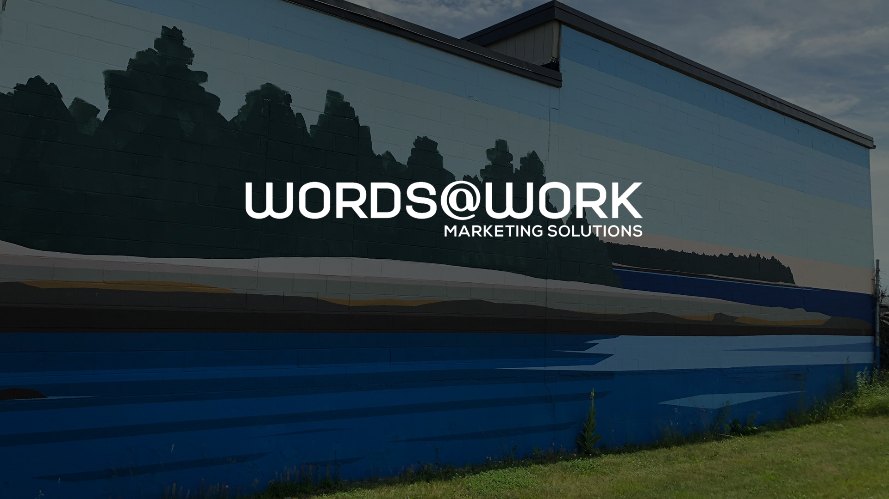
68 Commercial Street, 2nd Floor
Portland, ME 04101
207-797-0147

