Slide 1
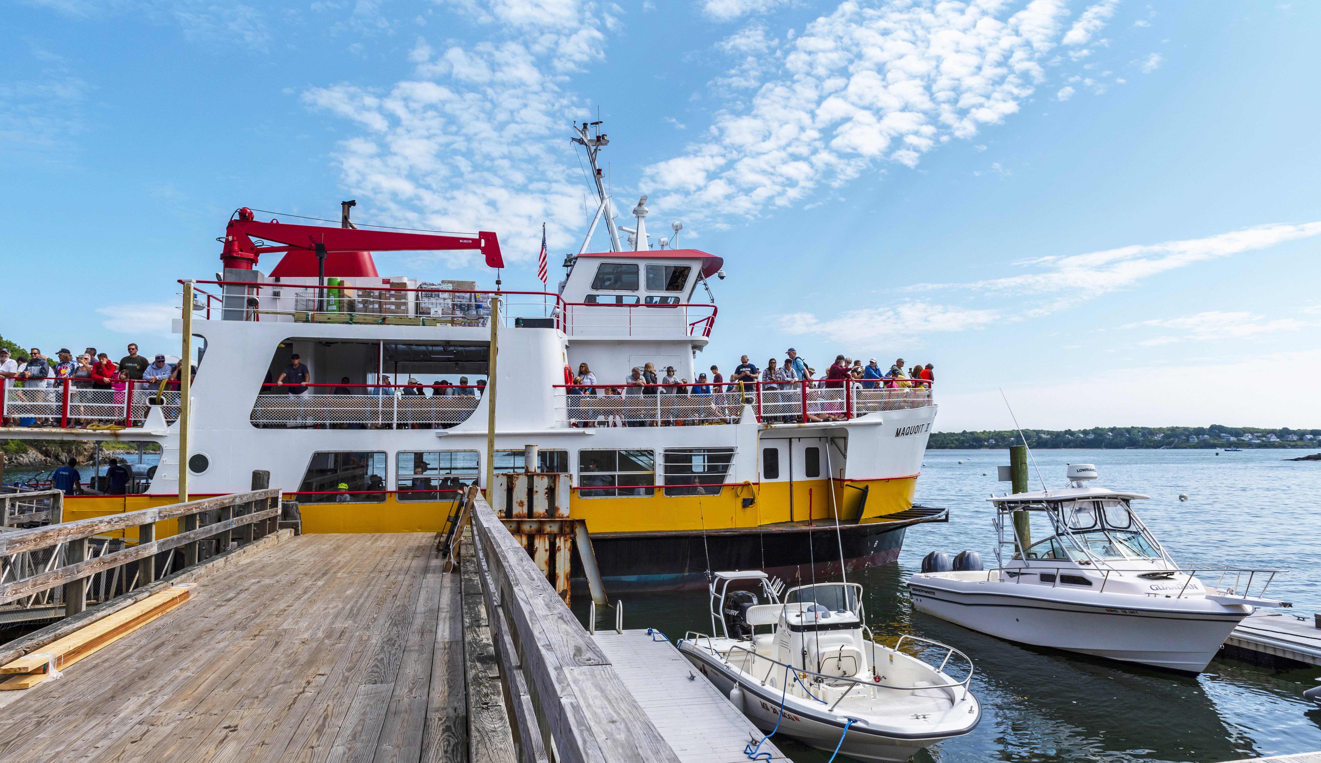


Slide 2
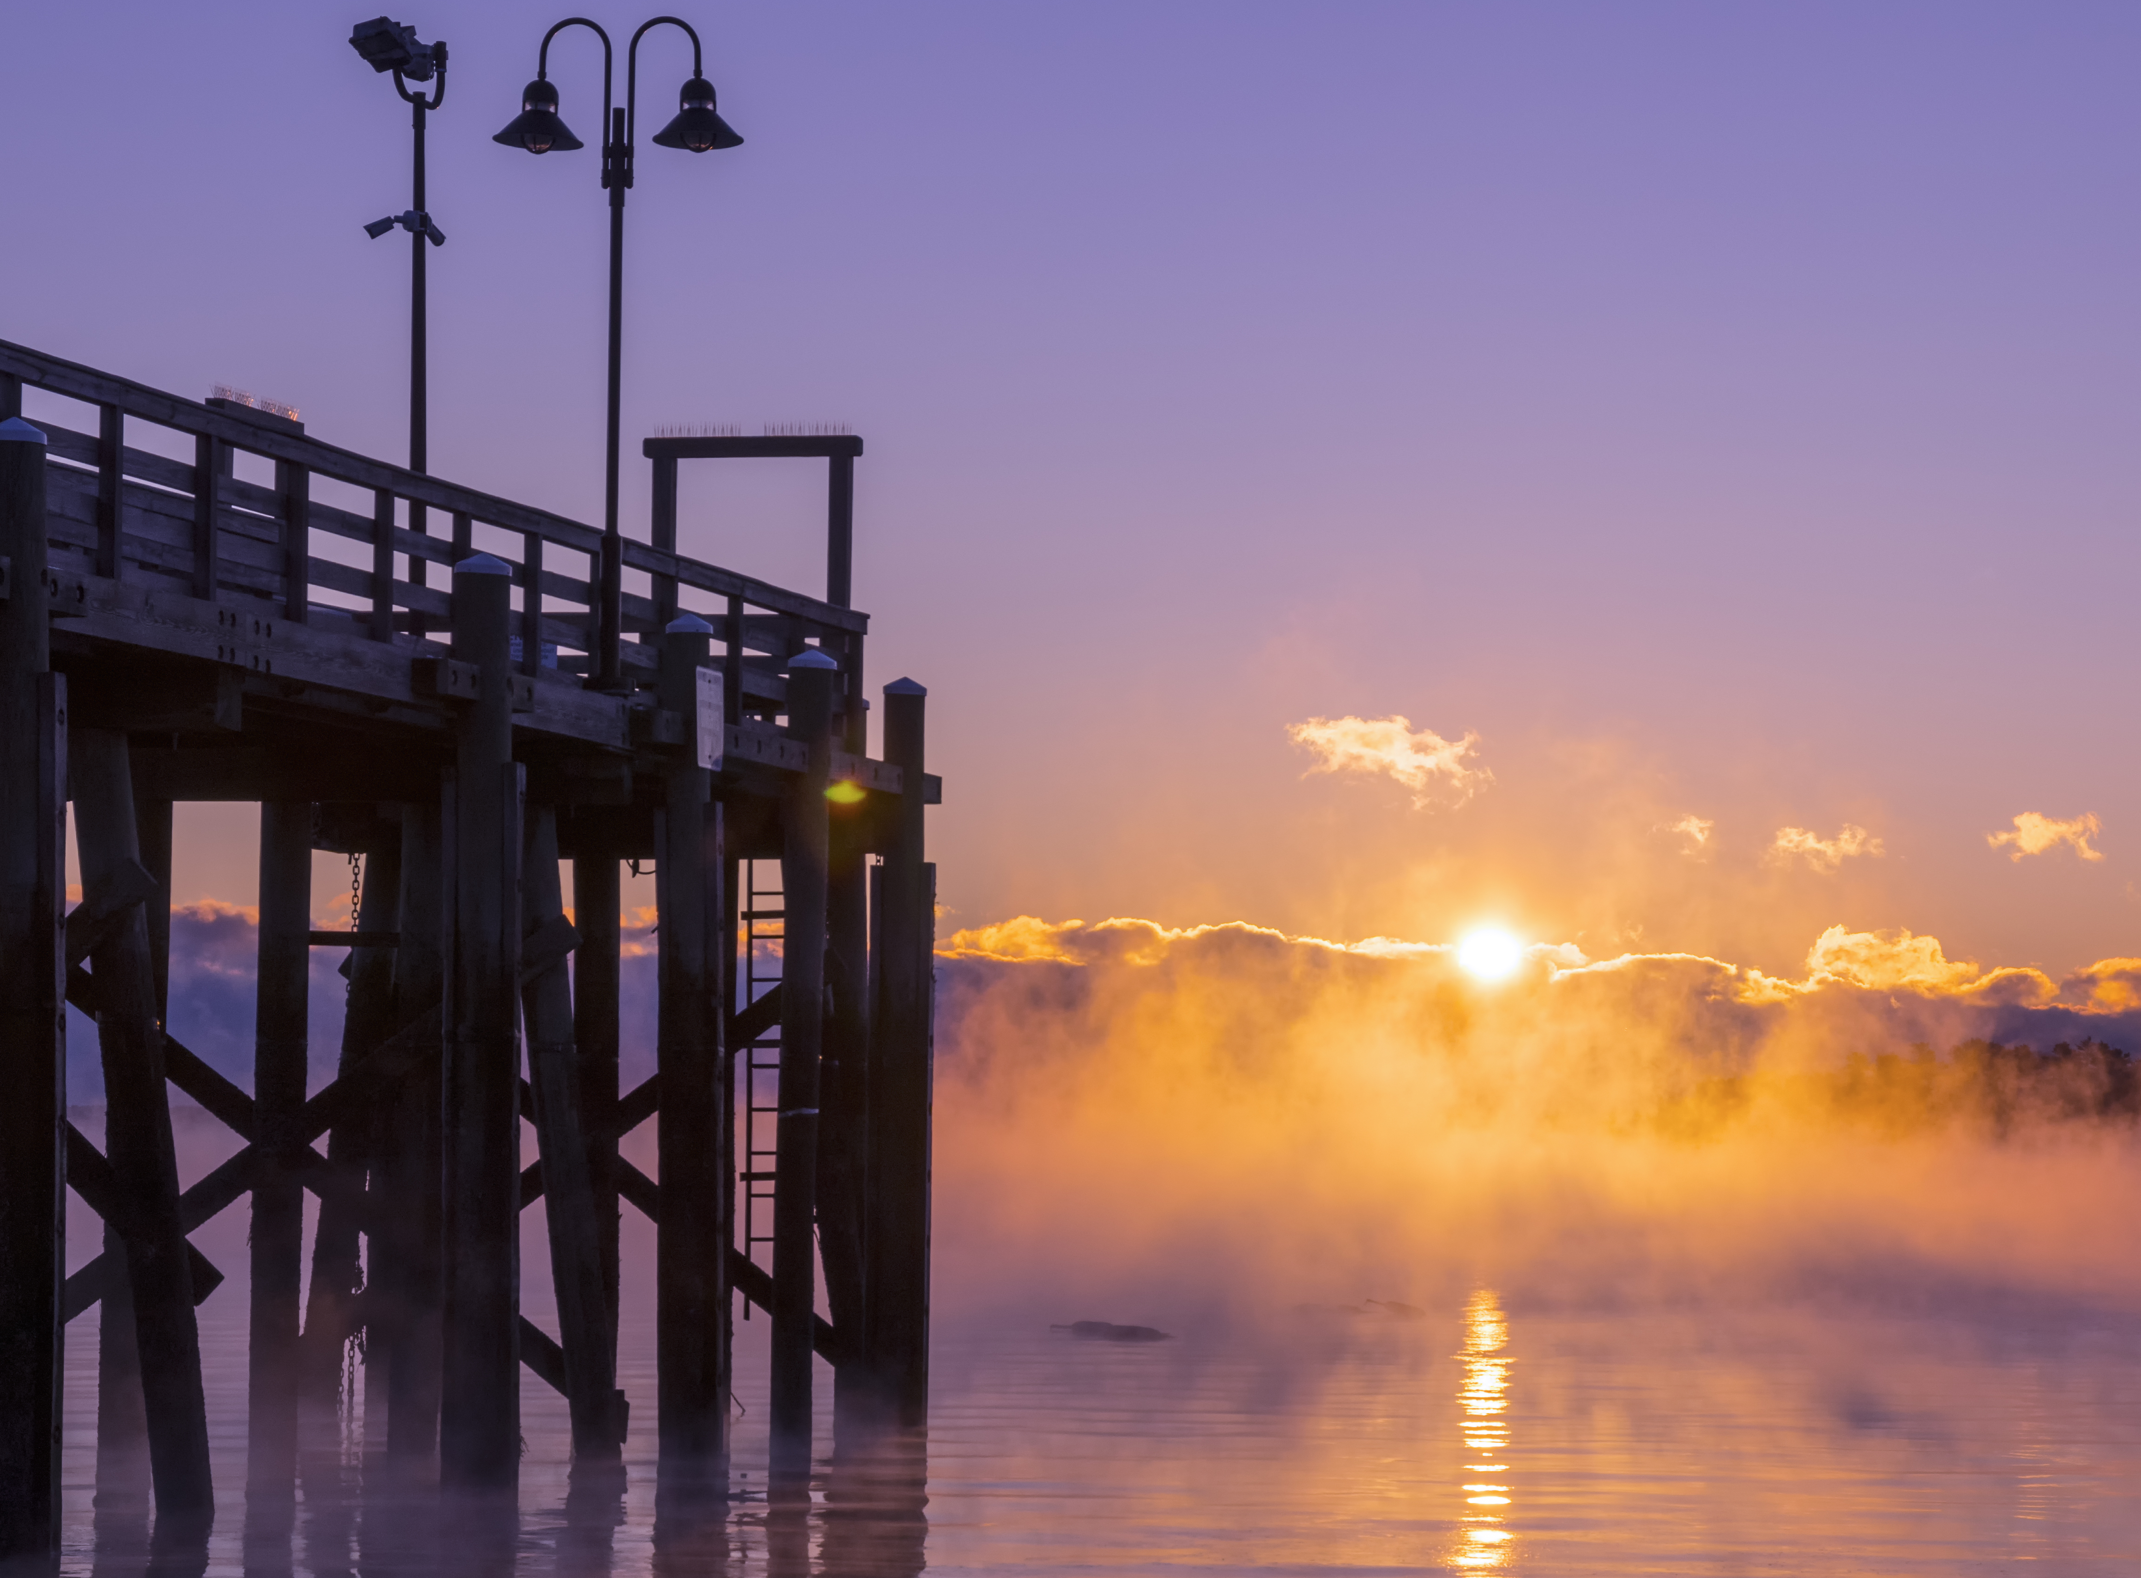
AGENDA
Who We Are
How We Are Different From a Chamber
What We Do
Evolution of Our Organization into Management

Slide 3
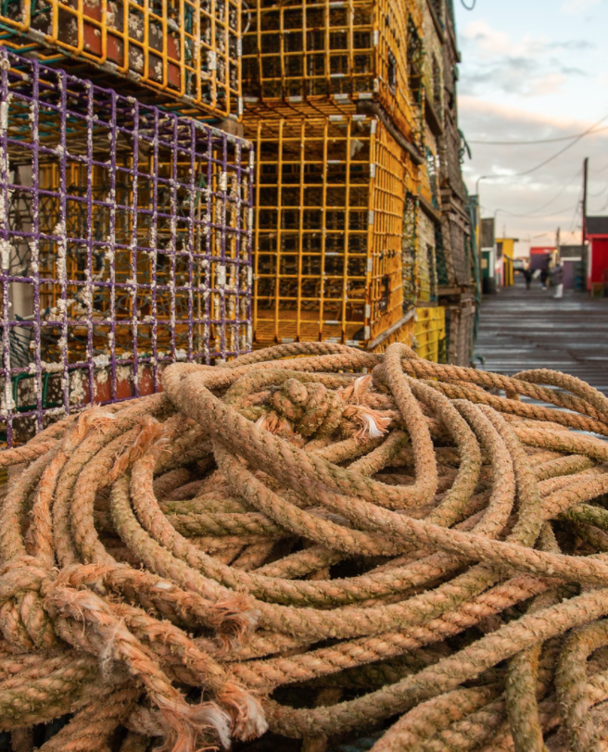
visit Portland: who we are
“Greater Portland Convention & Visitors Bureau” (CVB) Formed in 1982 (42 years old)
The official Destination Marketing Organization (DMO) for the Greater Portland Region.
Greater Portland: Scarborough to Freeport & incl. Gorham & Westbrook
In 2017, joined CVBs across the globe - now dba / “Visit Portland” - it’s a clear call to action and easily identifies what we do.

Slide 4
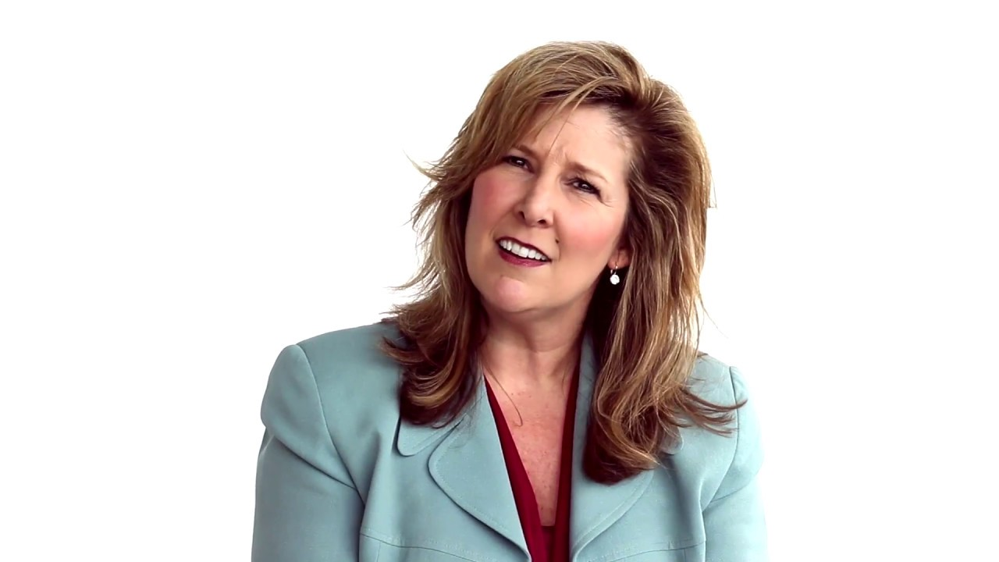
NAME CHANGE to Visit Portland

Slide 5
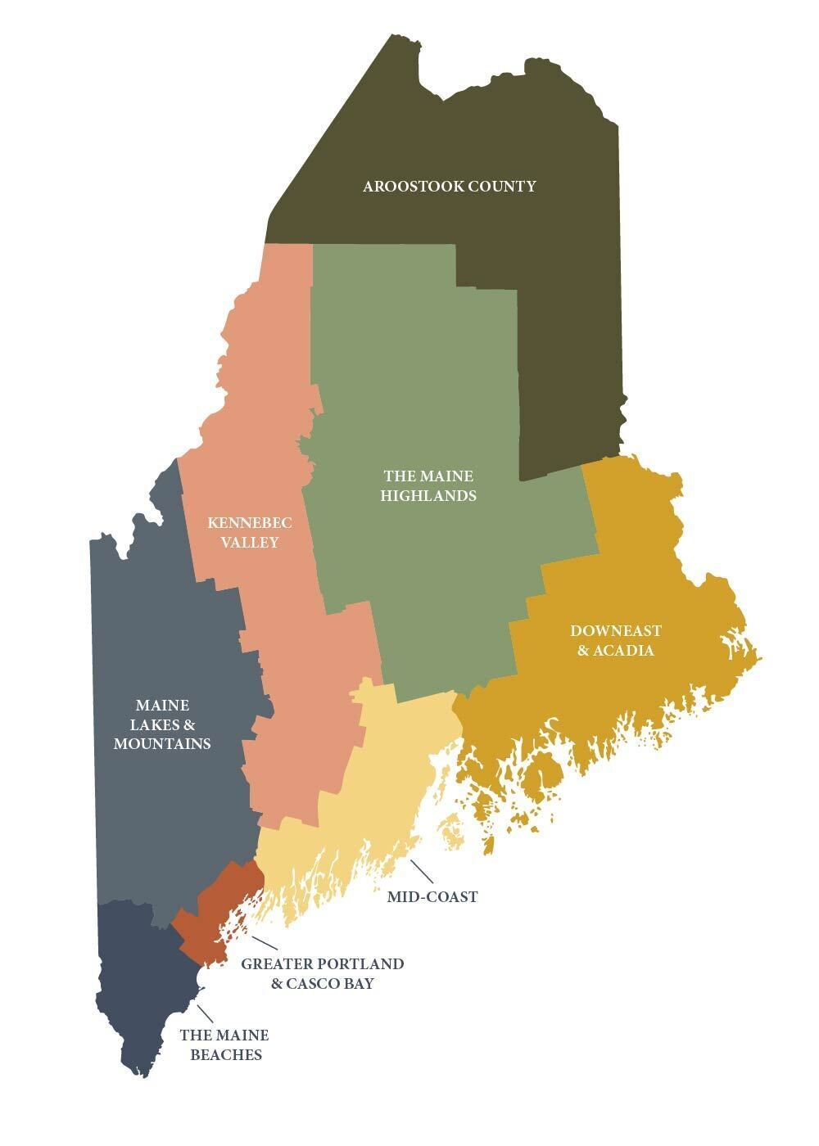
maine tourism
Office of Tourism (State Agency in Augusta)
8 Tourism Regions
1 Convention & Visitors Bureau (Portland)
GREATER PORTLAND REGION
SCARBOROUGH
CAPE ELIZABETH
SOUTH PORTLAND
PORTLAND
GORHAM
WESTBROOK
FALMOUTH
CUMBERLAND
YARMOUTH
NORTH YARMOUTH
FREEPORT
POWNAL
CASCO BAY ISLANDS

Slide 6
maine CHAMBERS
Lincoln Lakes
Machias Bay
Maine State
Mid-Maine
Norridgewock
Ogunquit
Old Orchard Beach
Oxford Hills
Penobscot Bay
Phillips
Piscataquis
Portland
Rangeley Lakes
River Valley
Sandford/Springvale
Scarborough
Schoodic Area
Sebago Lakes
Sebasticook
Skowhegan
Southwest Harbor / Tremont
Union
Vinalhaven
Wells
Winthrop Lakes
Wiscasset
Yarmouth
York Region
Bangor
Bar Harbor
Bath/Brunswick
Belfast
Bethel
Biddeford/Saco
Blue Hill
Boothbay
Bridgeton
Central Aroostook
Cobscook Bay
Damariscotta
Deer Isle/Stonington
Eastport
Ellsworth
The Forks
Fort Fairfield
Fort Kent
Franklin County
Freeport
Houlton
Jay/Livermore Falls
Kahtahdin
Kennebec Valley
Lewiston/Auburn
Limestone

Slide 7
DIFFERENCES BETWEEN A CVB | DMO AND A CHAMBER
CHAMBER
Their focus is on economic vitality through business generation.
They focus on advocacy to protect businesses
CVB | DMO
We focus is on economic vitality through visitor generation.
We focus on marketing our community
Both member-based organizations focused on the economic development of the community.
Both are conveners for each group to ensure vitality of the overall community.
In Maine, many Chambers do double work (Business & Tourism)
The Difference is the Outreach…

Slide 8
WE DO WHAT MOST PEOPLE THINK…JUST HAPPENS!

Slide 9
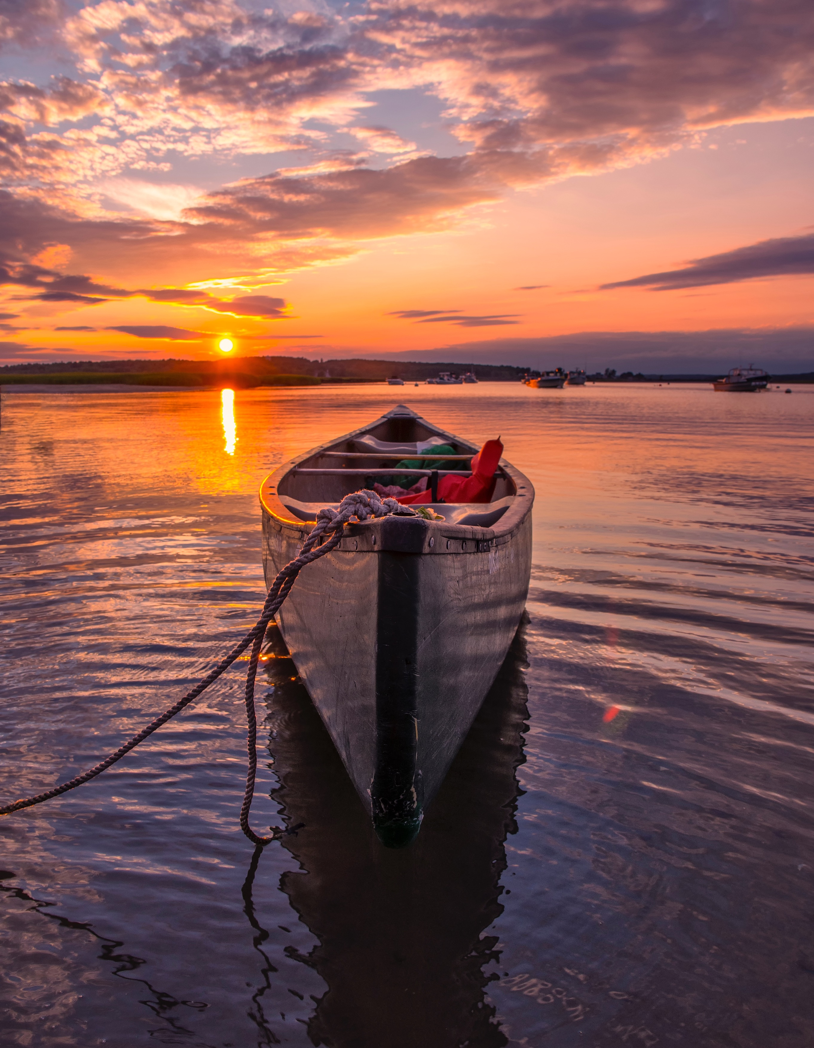
Leisure Visitors
Meetings & Conferences
Sporting Events
International Visitors
Motorcoaches
Destination Weddings
Media
Assist w/ Cruise Ships
BUT IT DOESN’T JUST HAPPEN…
All done through marketing efforts that tell our story and entices people to visit.

Slide 10
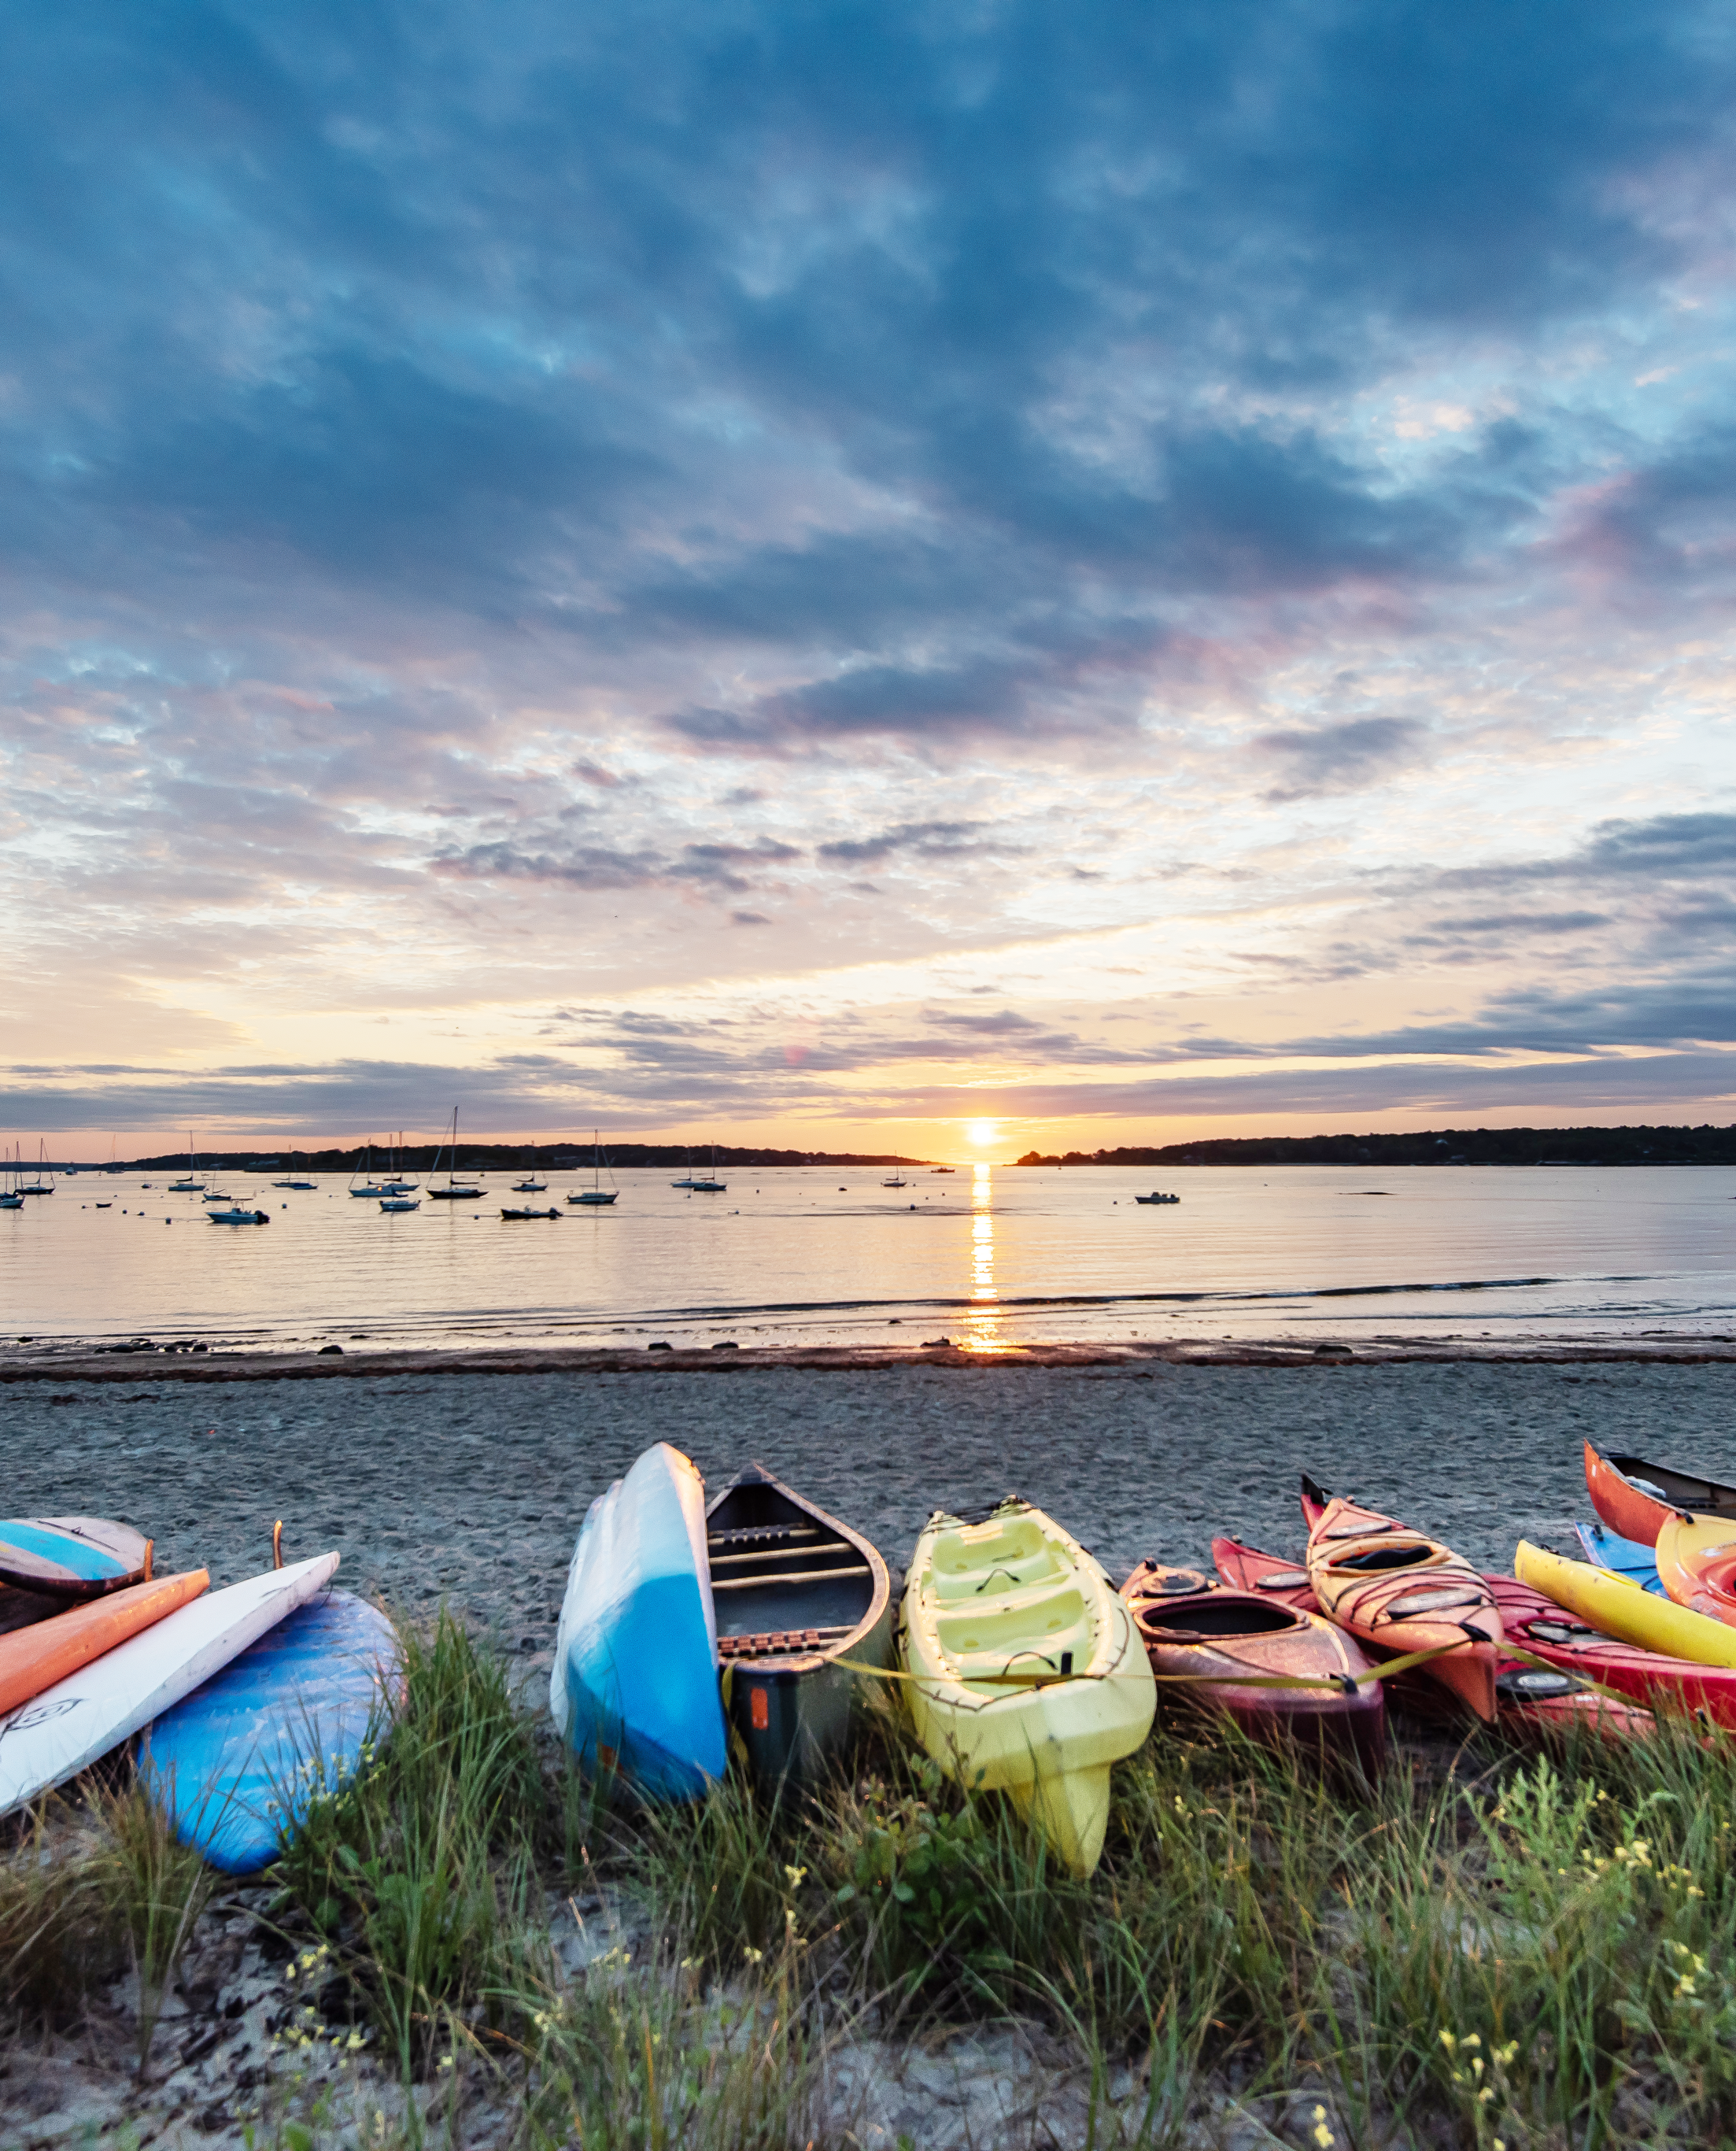
WE DO WHAT MOST PEOPLE THINK JUST HAPPENS
Actively Marketing, Year-Round, to Reach 8 Key Tourism Markets:
Leisure Visitors
Meetings & Conferences
Sporting Events
Destination Weddings
International Visitors
Motorcoaches
Cruise Ships
Media
2023
2.9 million visitors
Economic Impact of
$2.7 billion from visitor spending
21,400 jobs

Slide 11
…IT TAKES MARKETING - LOTS OF IT!
Brand Awareness
Digital Advertising
Digital Retargeting
Social Media Advertising & Engagement
Print Marketing - including article generation
E-marketing
Tradeshow representation
Sales Missions
Web Development
Photo & Video Development
Streaming, TV, and Radio
Visitor Services
We must constantly be marketing to keep our destination viable and make it a great place to live and work.

Slide 12
IT’S ALL ABOUT WORKING TOGETHER FOR ONE GOAL
“COMMUNITY VITALITY”

Slide 13
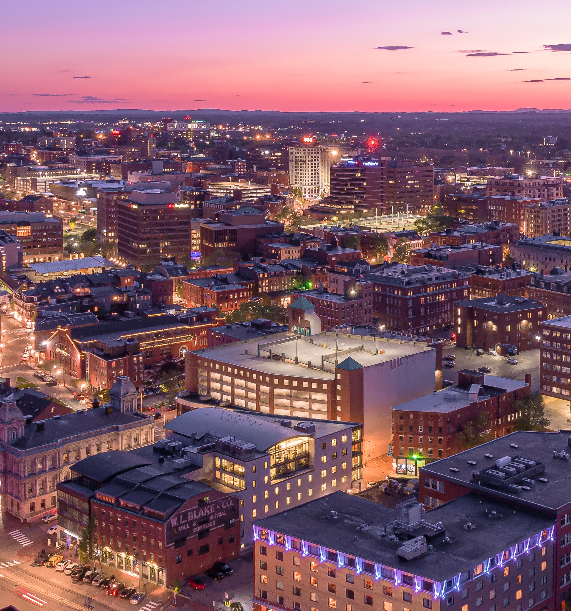
NOT JUST ABOUT VISITORS
DESTINATION MARKETING BUILDS OUR COMMUNITY
Every community competes for:
        Attention | Respect
        Workforce | Residents
        Business | Capital Investments
To be successful, people need to be made aware
        Hear about your community
        Find it online
        Shown that it’s a great destination
        Have a positive image in their mind
        Need to want to visit, live, and work here!

Slide 14
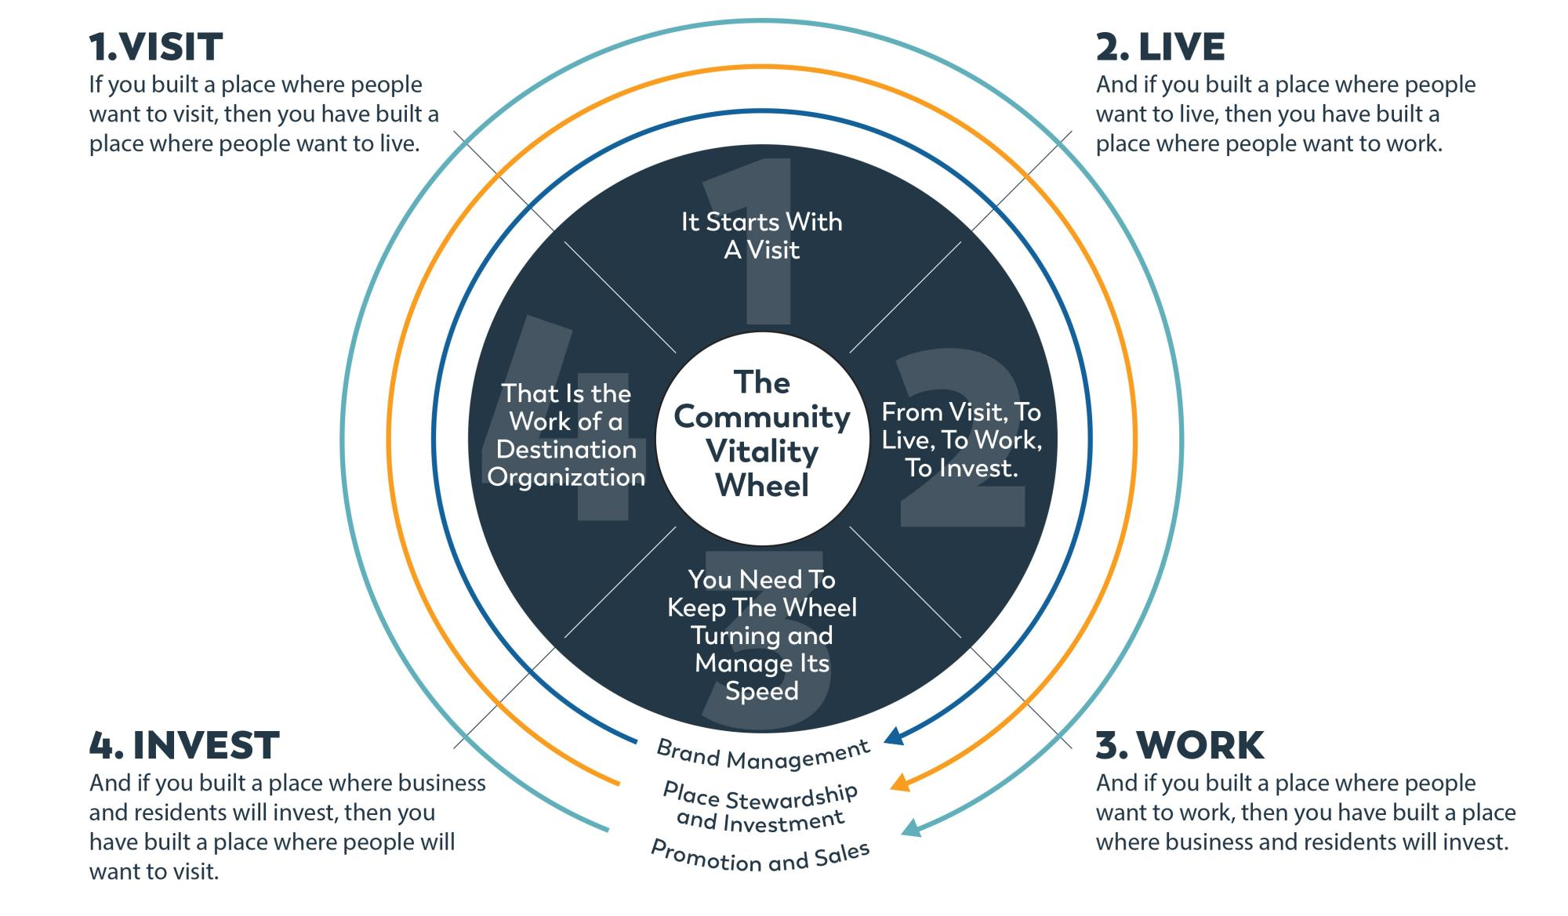

Slide 15
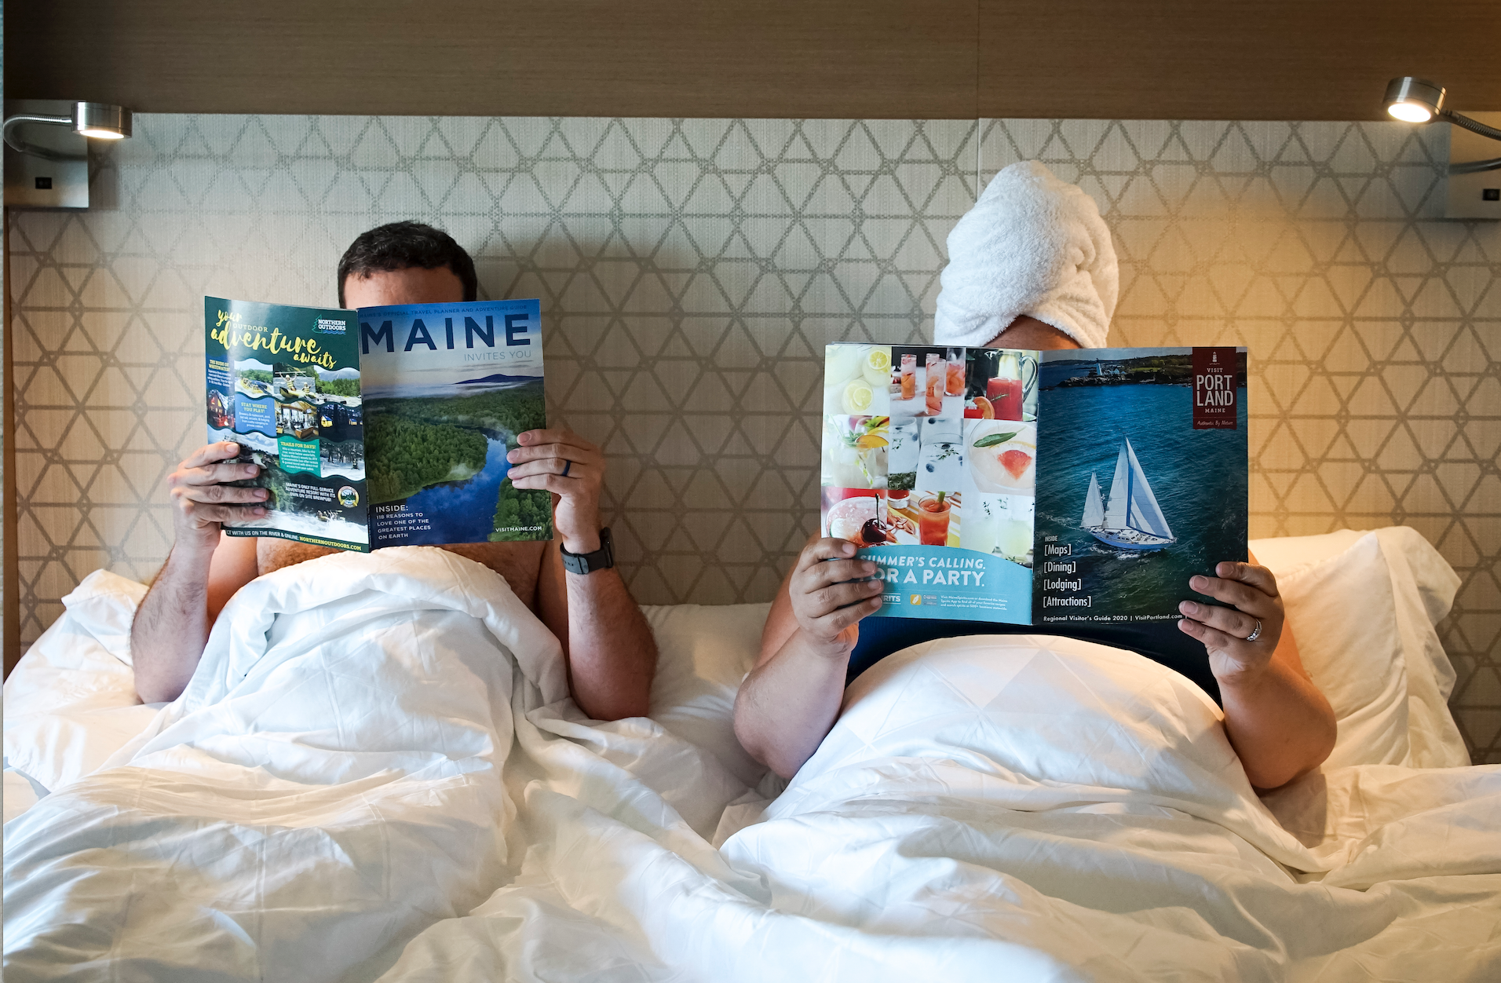
visitor spending EXPANDS BEYOND HOTELS
Traditional Spending Locations
Airport, Train, Bus, Uber, Taxi
Hotels, Inns, B&Bs, Campgrounds
Restaurants, Coffee Shops, Bakeries
Tour boats, Trolleys, Sightseeing
Museums + Cultural Institutions
Artists + Galleries
Retail shopping
Recreation & Sports
Bars, Breweries, Distilleries
Drug Stores , Grocery Stores
Gas, Parking, + Tolls
In general, people do not come to Portland for their hotel room. They come for the unique experience of this great city and state. Higher year-round hotel occupancy levels increases consumer spend at other area business providing them them with more stability.

Slide 16
Non-traditional Spending Locations
BUSINESSES SUPPORTED BY HOTELS ALONE
45 TOTAL BUSINESSES
As a year-round lobsterman, I value and count on the visiting public and a strong tourism economy to get us through the quieter times of the year. Keeping Portland’s waterfront viable helps all the local lobsterman & fisherman and keeps Portland authentic. We appreciate the industries support in protecting and preserving our working waterfront.
Tom Martin
Portland-based Lobsterman

Slide 17
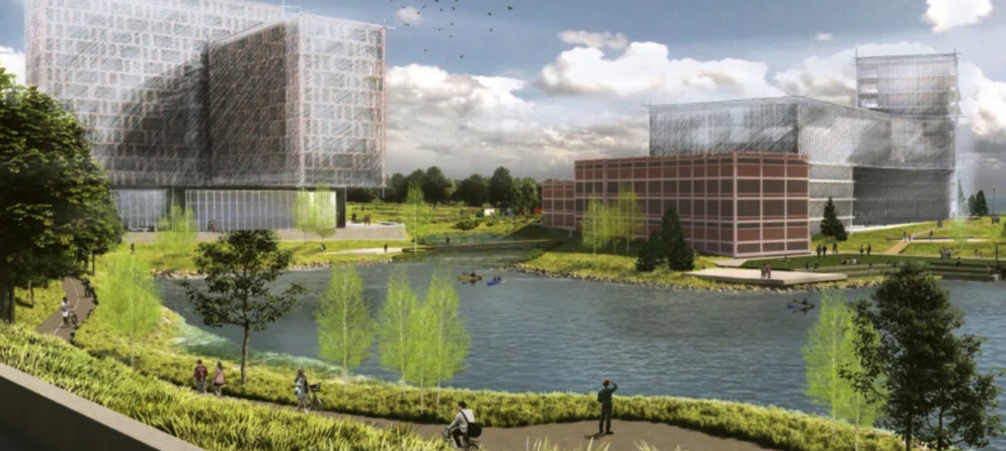
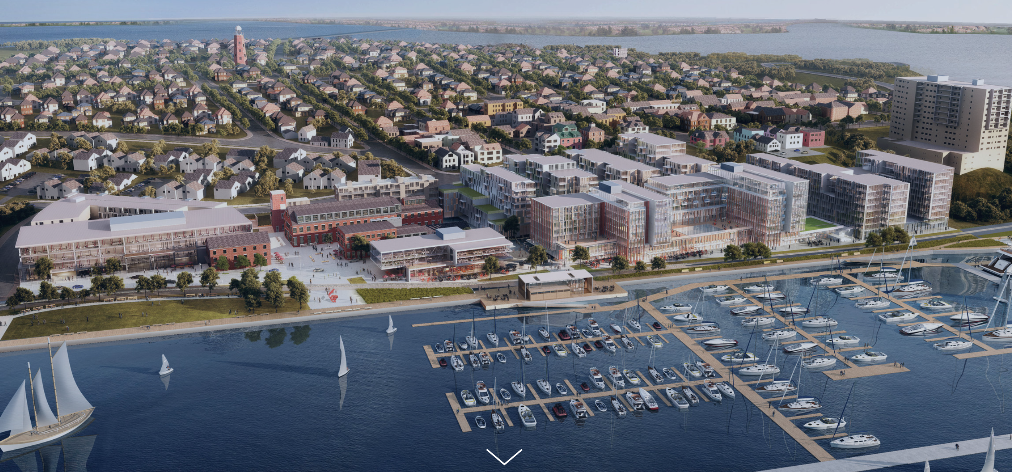
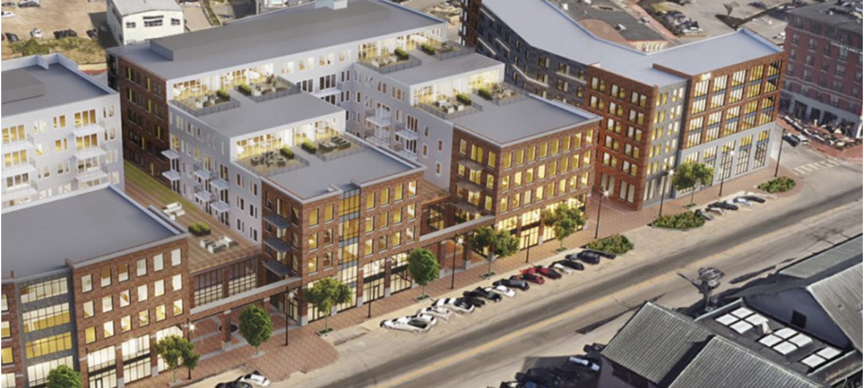
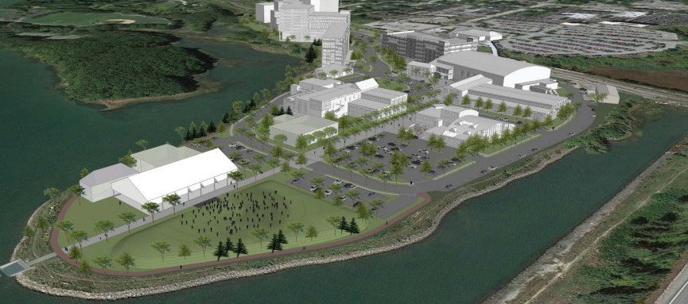
OUR COMMUNITY IS GROWING
Each new mixed-use development includes a hotel project because developers understand that a strong visitor economy supports their investment
ROUX INSTITUTE
58 FORE
HOBSON LANDING
THOMPSON'S POINT

Slide 18
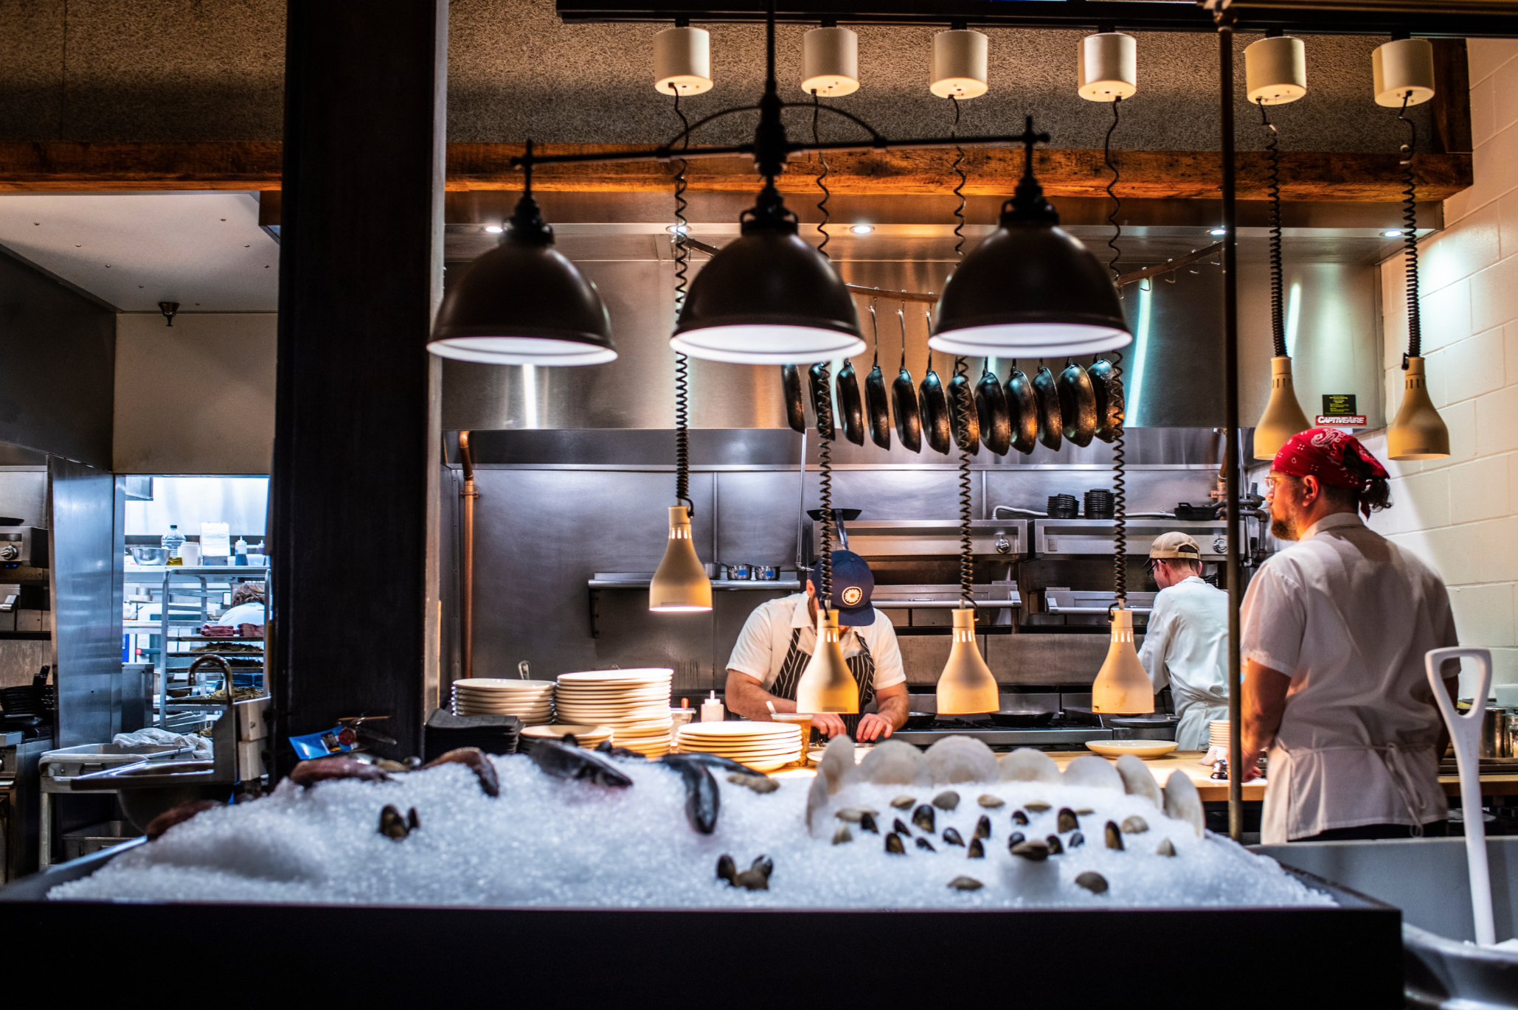
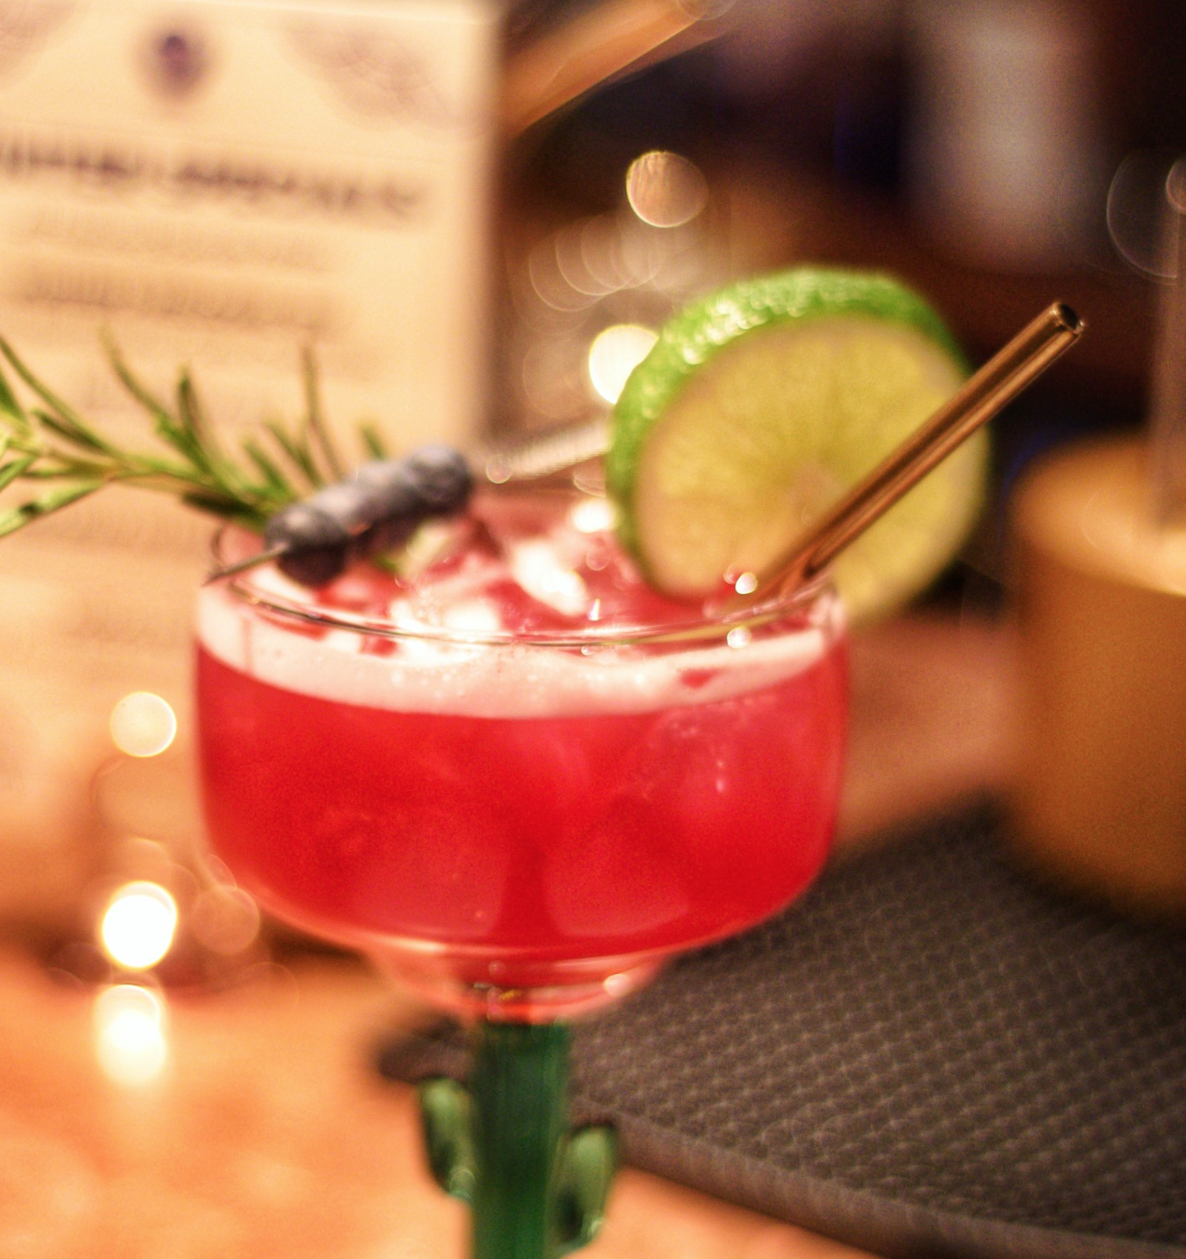
portland
food + beverage
According to the Portland Food Map there are:
539 eating & drinking establishments in Portland
_____________
99 are restaurants with ethnic cuisine
98 American, Seafood, Pubs, BBQ, Steakhouses
61 Pizza, Diners, and sandwich shops
66 coffee shops, bakeries, ice cream
17 Variety stores and fish markets
31 International markets
100 Bars, Breweries, and Distilleries
67 Food trucks and food carts
66,000 residents

Slide 19
EVOLUTION INTO DESTINATION MARKETING “& MANAGEMENT” ORGANIZATIONS

Slide 20
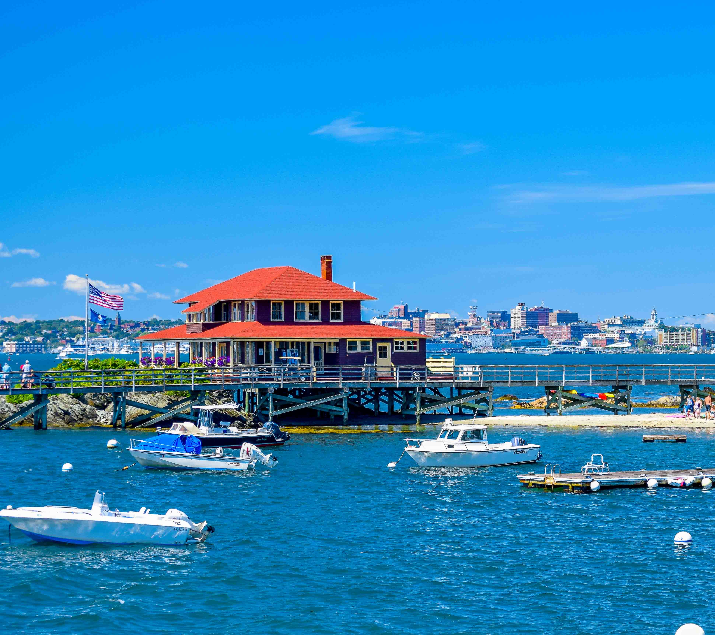
destination MARKETING + Management ORGANIZATIONS
We don’t want to be victims of our own success
Manage the flow of visitation: Geographically and seasonally
Encourage sustainability: Visitors to respect our destination
Collaborate: Working with local stakeholders to focus on ensuring visitors, businesses, and residents, visit, work and live together cohesively

Slide 21
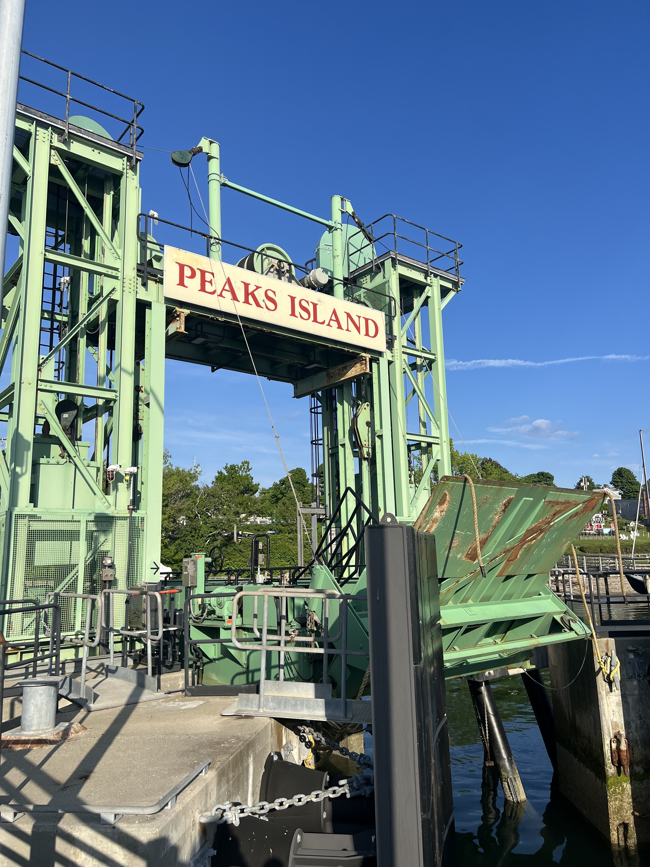
PEAK’S ISLAND:
“THE CONEY ISLAND OF MAINE”
Visit Portland had a story depicting the history of Peak’s Island - but that set up unrealistic expectations
Worked with Peter Eckel
Changed all messaging online and with our information center specialists

Slide 22
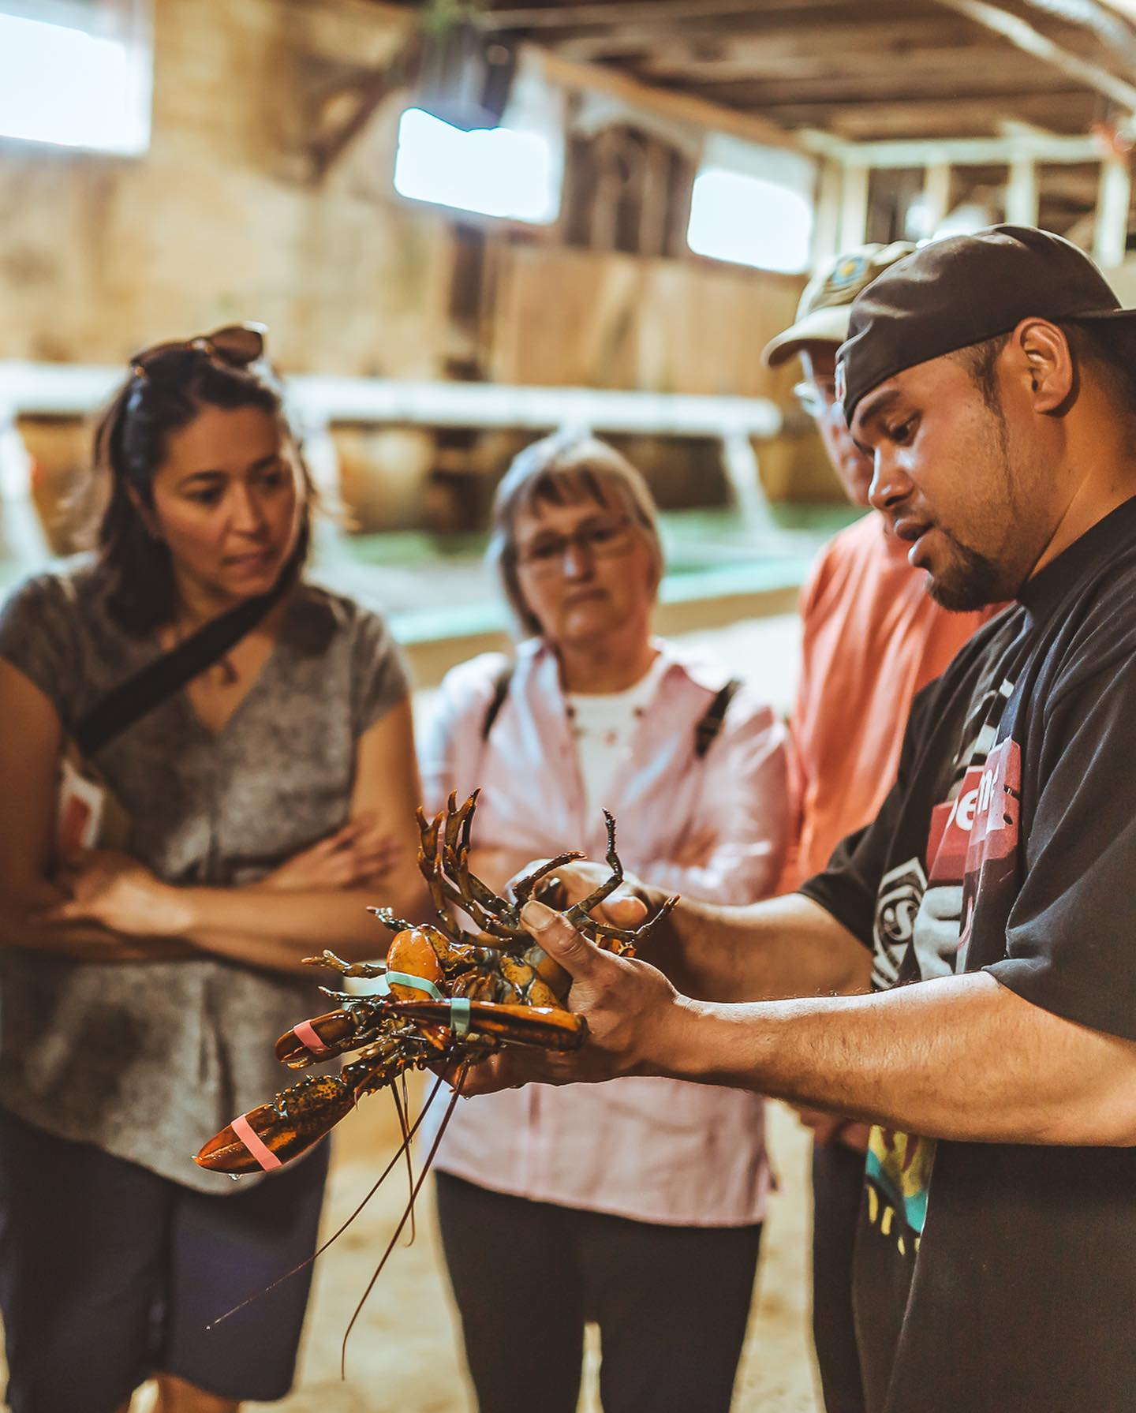
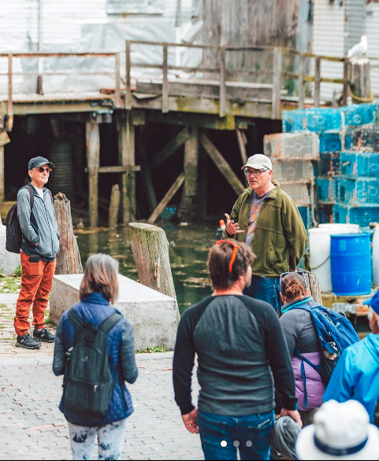
WALK THE WORKING WATERFRONT
Started with a conversation about not being able to hire a CFO in 2014
Charlie Poole
Jon Hathaway
John Spritz
Bristol Seafood?

Slide 23
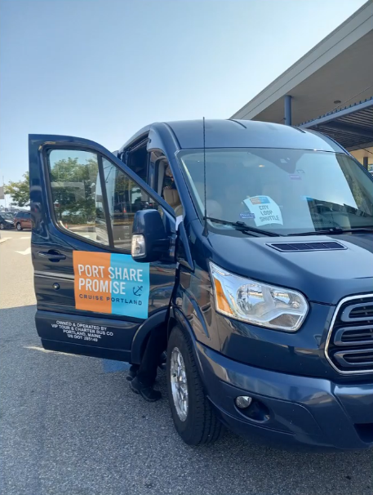

PROMISE – PORTSHARE year 2
City Loop Shuttle - 6,000 passengers
Partnered with VIP Tour & Charter Bus
Community Involvement
Feedback From : Emissions, Shuttle, Crosswalk Guards
Goal: Reduce pedestrian traffic on Commercial Street & spread economic benefit of cruise tourism to more businesses in Portland
Goal: To have a place for community members to share any comments, criticisms, and compliments during the cruise season.

Slide 24
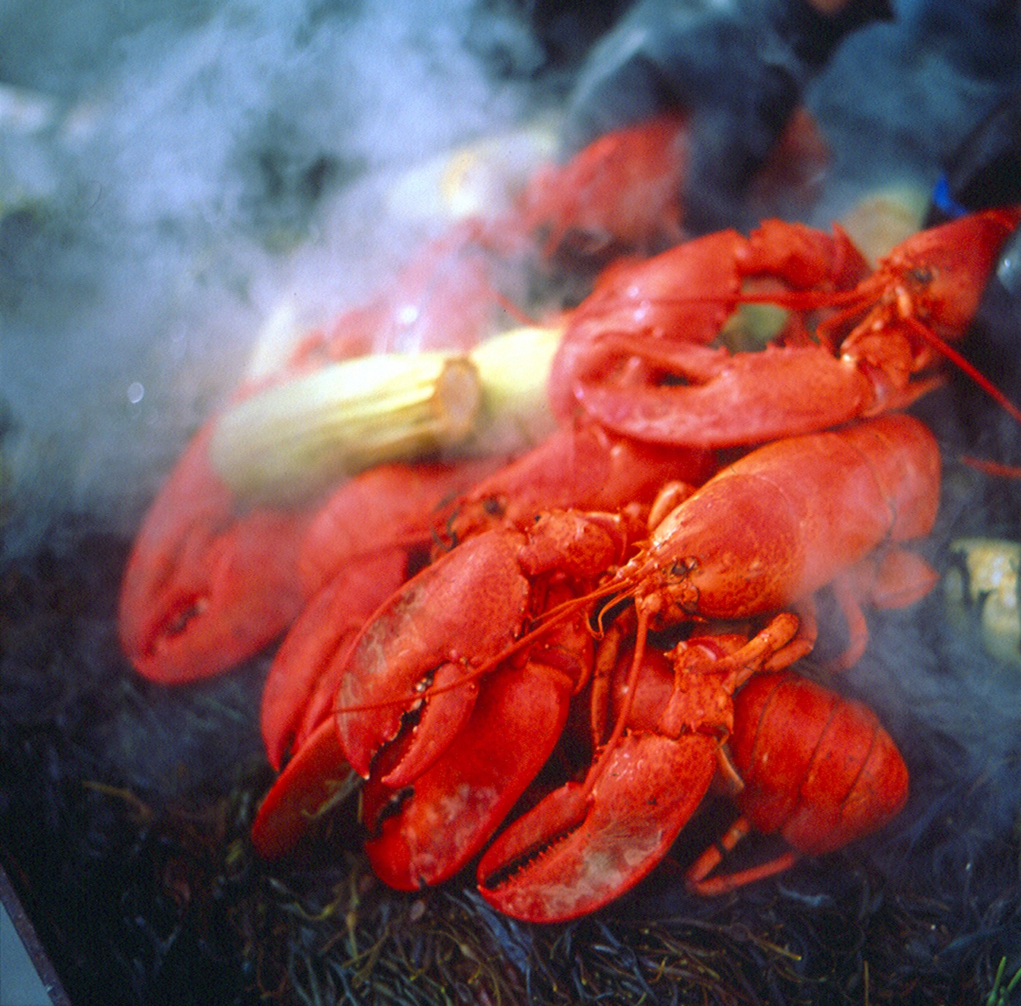
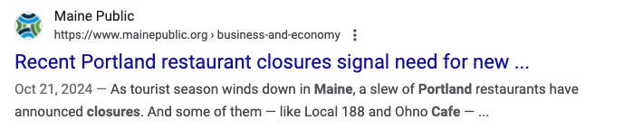
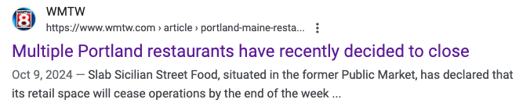
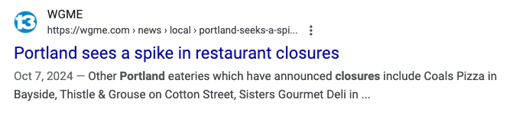
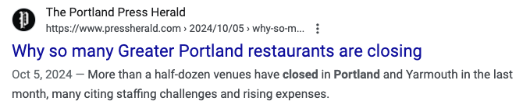
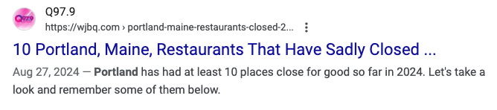
RESTAURANT CLOSURES

Slide 25
