Slide 1
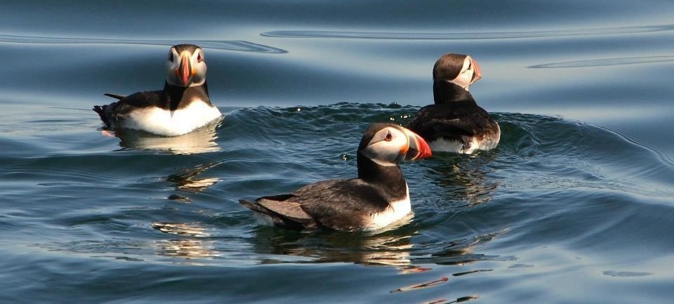
Sales + Marketing Meeting
Photo Credit : Cap'n Fish's Cruises

Slide 2
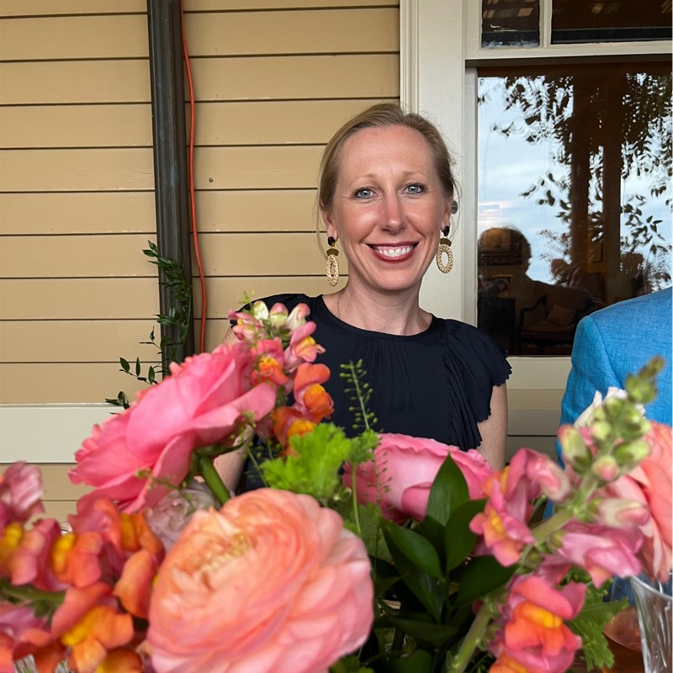
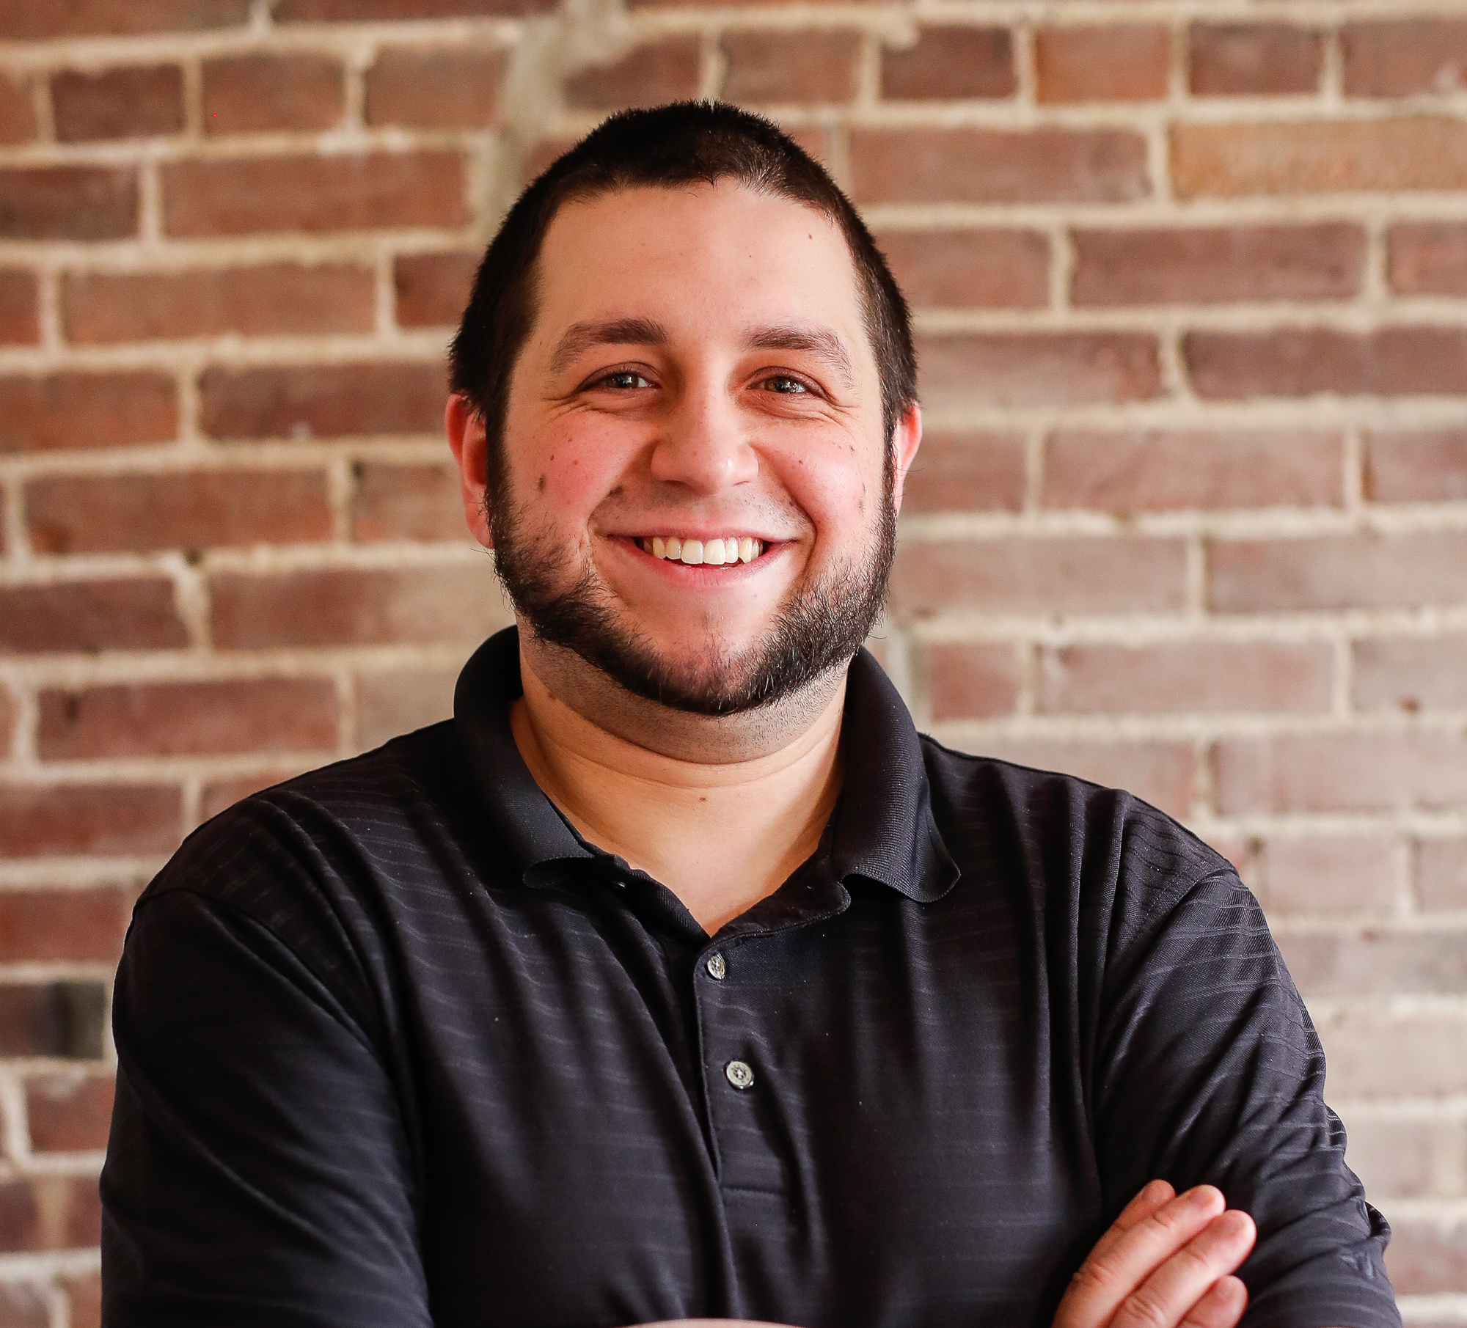
AGENDA
Welcome | The Brunswick Hotel
flyte new media | John Paglio
Digital Edge FAM Tour
Small + Boutique Meetings Co-Op
Round Table Discussion

Slide 3
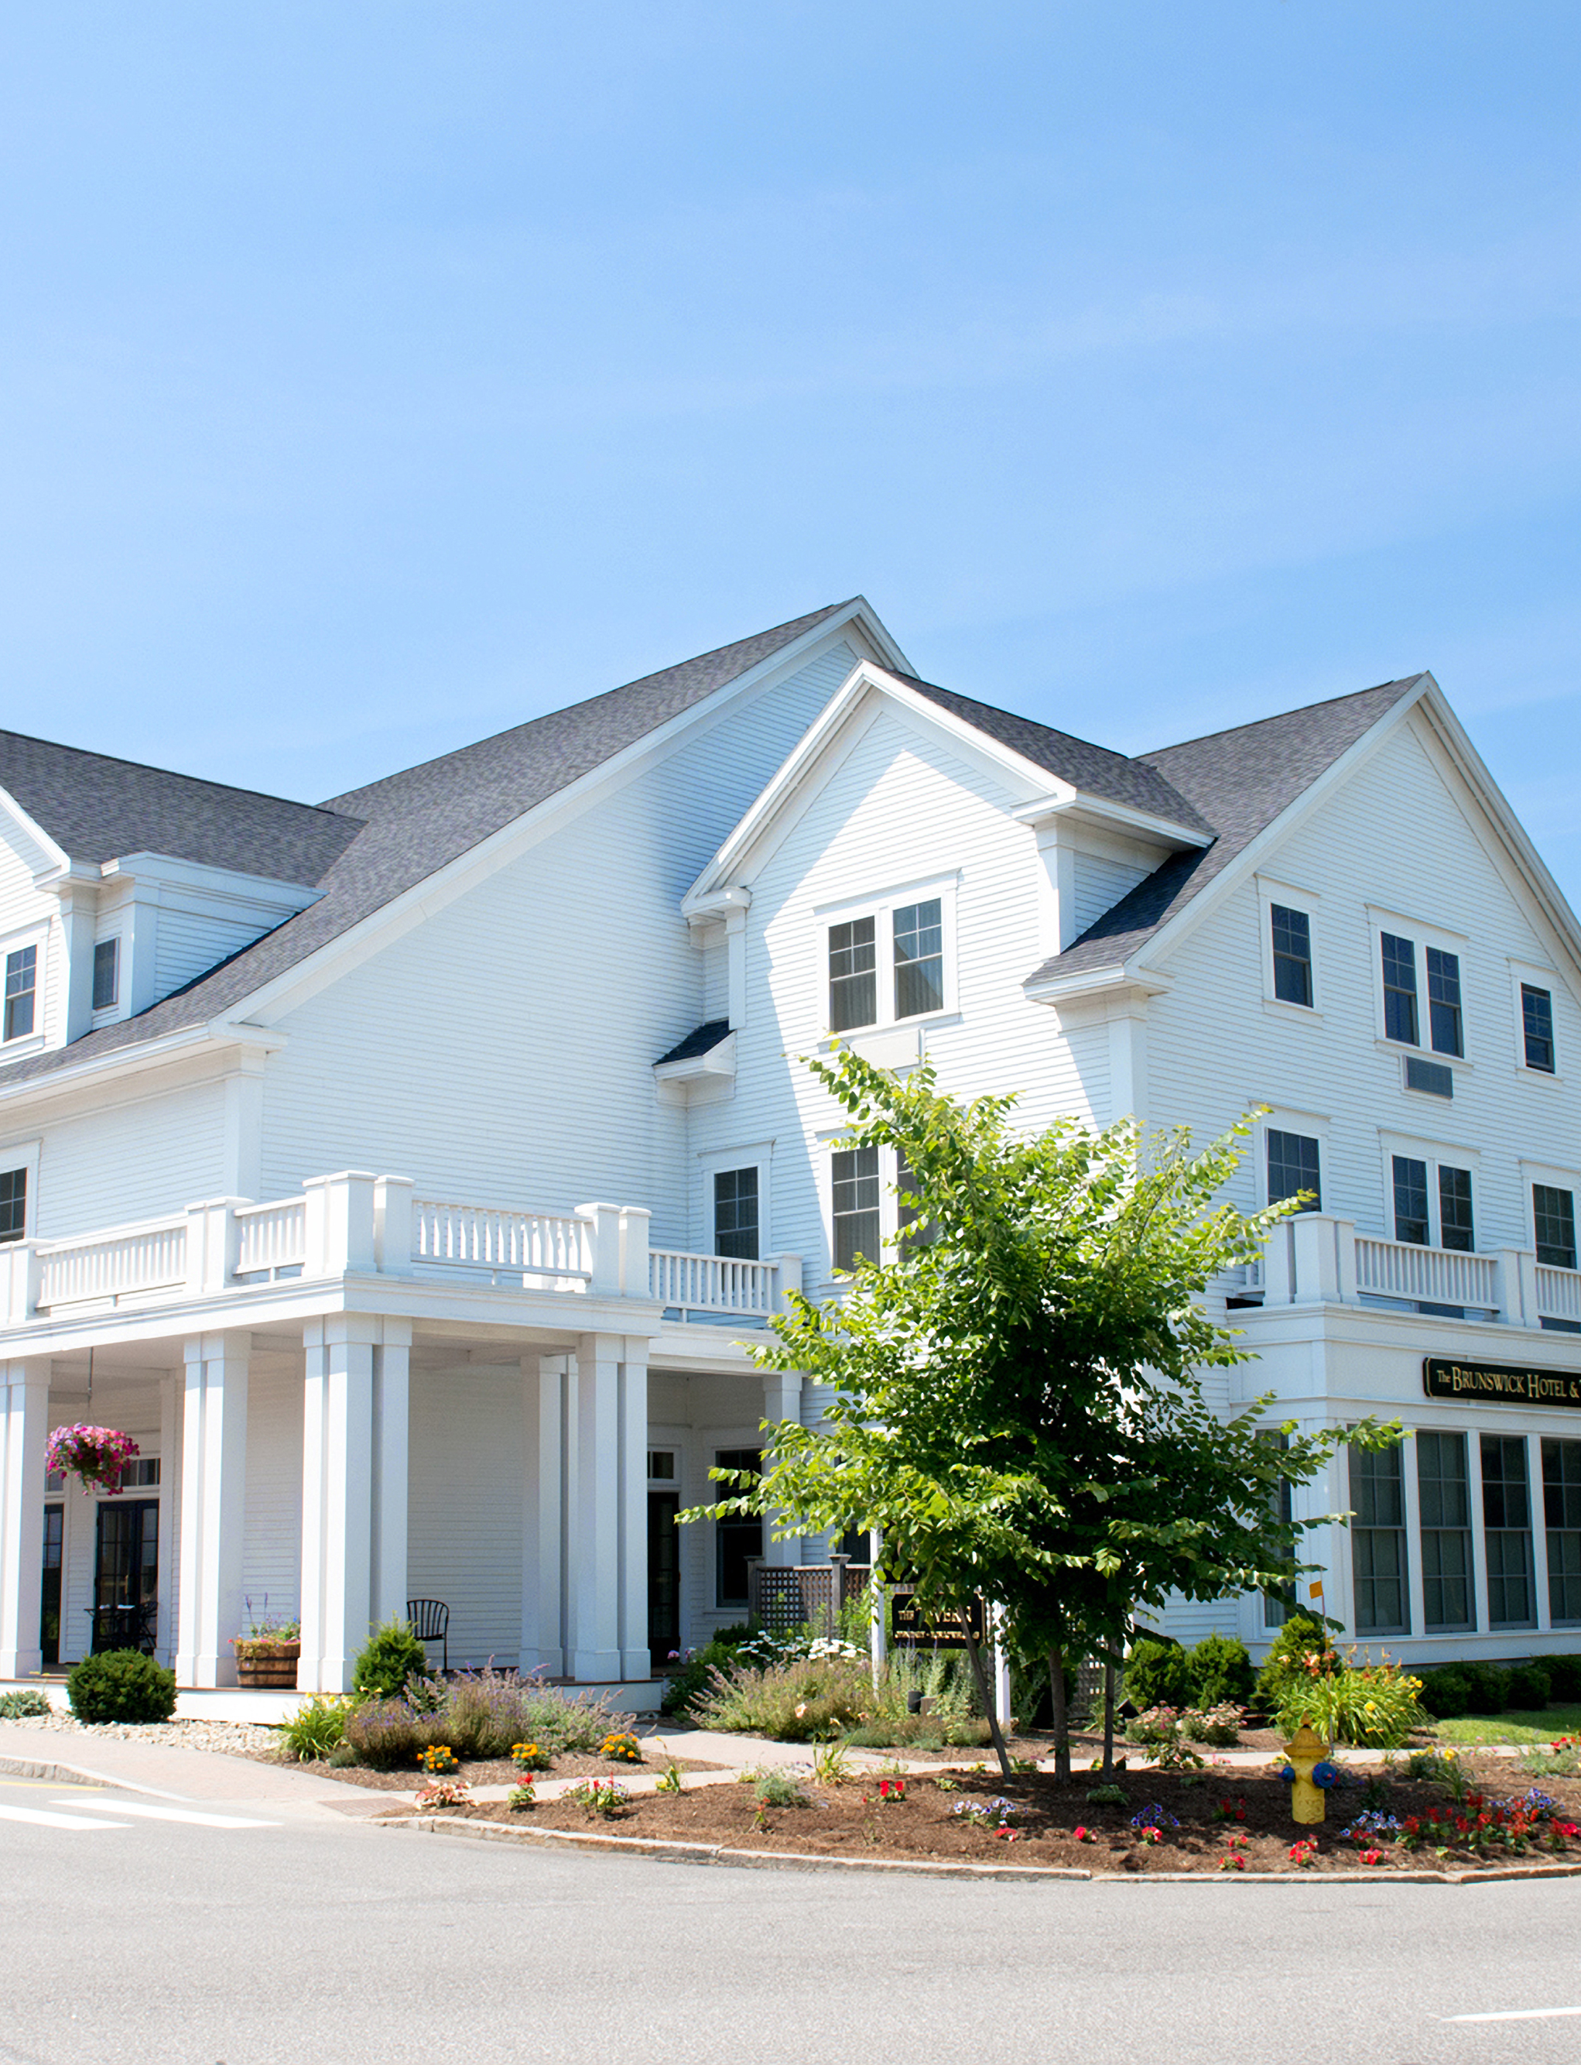
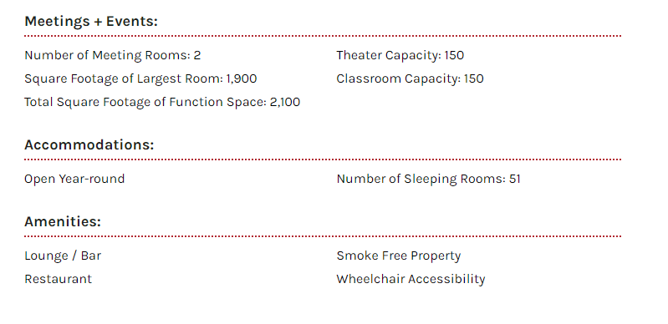
THE BRUNSWICK HOTEL

Slide 4
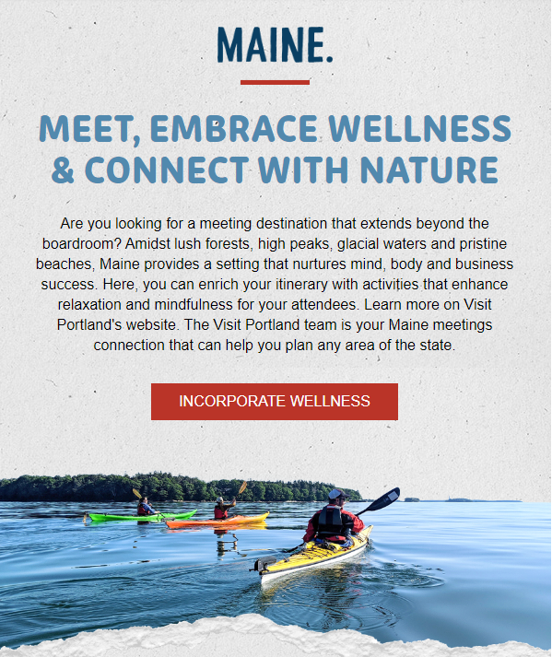
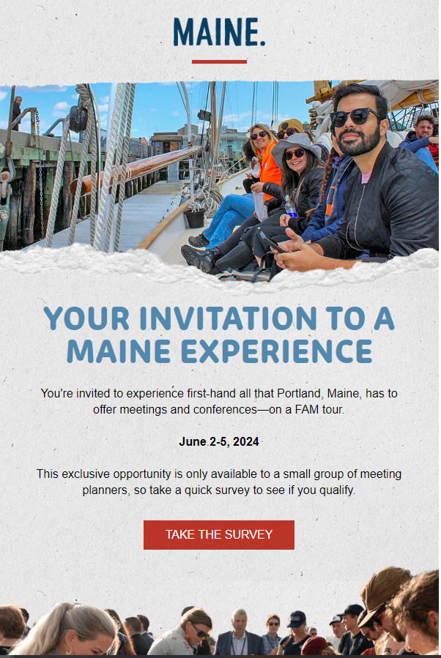
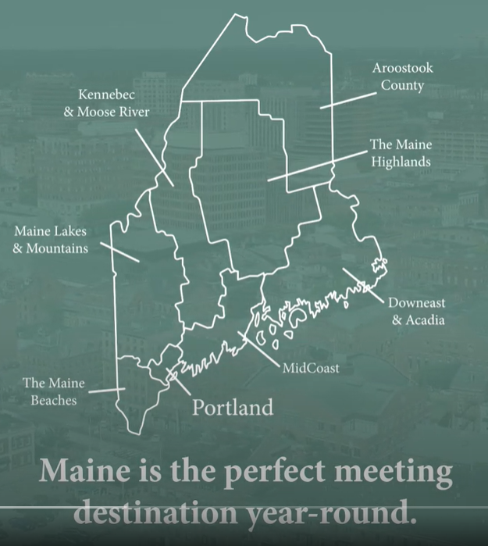
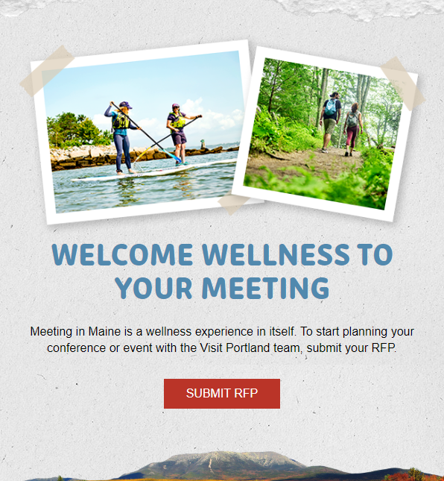
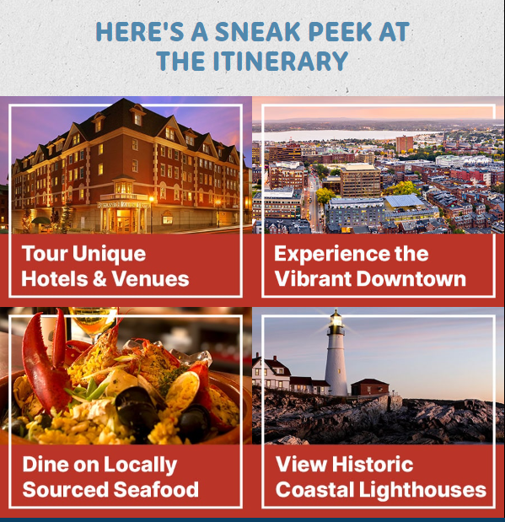
Digital Edge
Maine Meeting Newsletter
Meet in Maine Campaign
Video #4​
FAM Tour
Endless Year-Round Adventures Await Meeting Attendees in Maine

Slide 5

Louisville, KY | June 9-11, 2024
1:1 appointments | Networking | Education
Co-Op Opportunities

Slide 6
SimpleView Housekeeping Notes
Requests for Information​ (RFI)
Internal Response​
Send your information to the planner to market directly to their audience
Be featured on the event’s website
  NASFA: Tours & Activities
Give the planner the opportunity to have your information on file for present and future events
Allow me to streamline communication with the planner by responding YES or NO via Simple View
Let me know that your team has seen it, preventing a reminder email

Slide 7
Round Table Discussion
Photo Credit : Cap'n Fish's Cruises

